Slide 1
Algorithm : Random Forest(Regression)
Presented by ,
Kavya K C

Slide 2
Agenda
INTRODUCTION 3
MACHINE LEARNING 4
RANDOM FOREST REGRESSION 5
IMPLEMENTATION 10
DEPLOYMENT 13

Slide 3
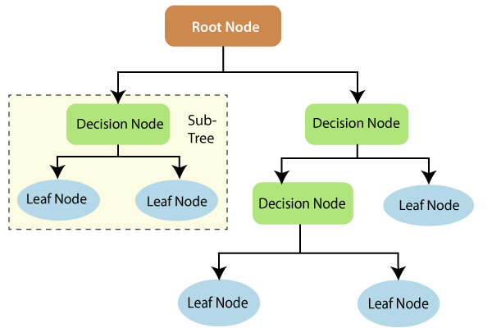
Introduction (Random forest Regression)
Random Forest is a powerful and versatile supervised machine learning algorithm that grows and combines multiple decision trees.
Random forest regression is a machine learning algorithm that is used for regression tasks.
It is a type of ensemble learning algorithm that combines the results of multiple decision trees to make more accurate predictions.

Slide 4
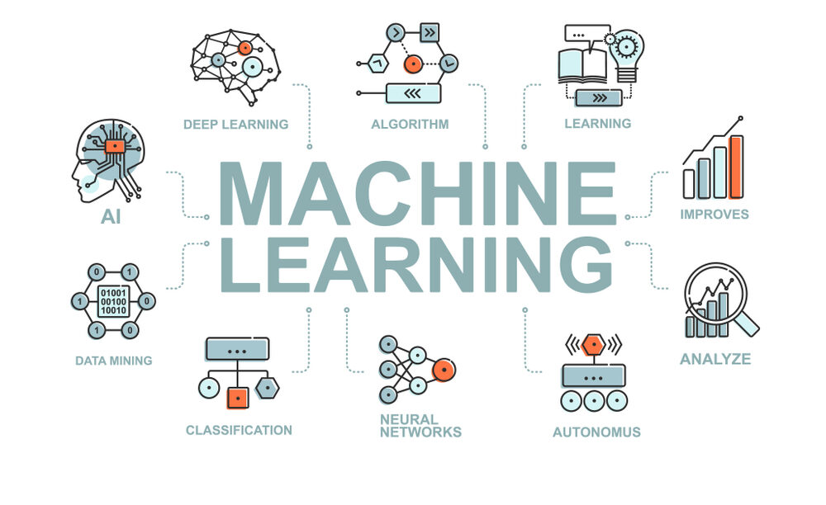
Machine learning is a field of computer science and artificial intelligence that involves developing algorithms and statistical models that enable computer systems to automatically learn from data and improve their performance on a specific task over time.
machine learning is a way of teaching computers to make predictions or take actions based on patterns in data, without being explicitly programmed to do so.
Machine learning has a wide range of applications in areas such as image and speech recognition, natural language processing, recommendation systems, fraud detection, and many others.

Slide 5
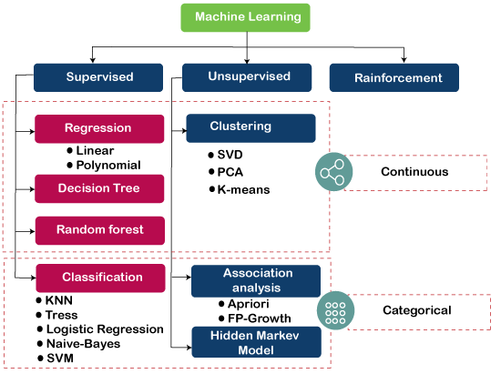
Types Of machine Learning
Supervised learning involves training a model on labeled data, which means the input data has a corresponding output or target variable that the model is trying to predict.
Unsupervised learning, on the other hand, involves training a model on unlabeled data, which means the input data does not have any corresponding output or target variable.

Slide 6
Regression & Classification
Regression Algorithm | Classification Algorithm
In Regression, the output is a continuous or numerical value. | In Classification, the output is a discrete or categorical value.
Regression model maps the input variable(x) with the continuous output variable(y). | Classification model maps the input variable(x) with the discrete output variable(y).
In Regression, we find the best fit line that can predict the output accurately. | In Classification, we find the decision boundary that can divide the dataset into different classes.
Regression algorithms solve regression problems such as house price prediction, cryptocurrency price prediction, etc. | Classification algorithms solve classification problems such as face detection, speech recognition, etc.
Regression algorithms can be further divided into Linear and Non-linear Regression. | Classification algorithms can be divided into Binary classifiers and Multi-class classifiers.

Slide 7
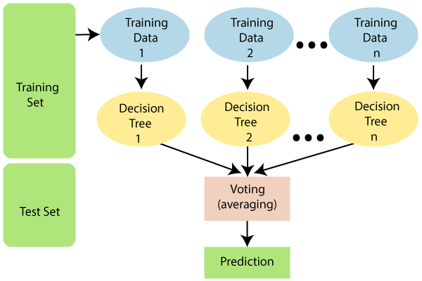
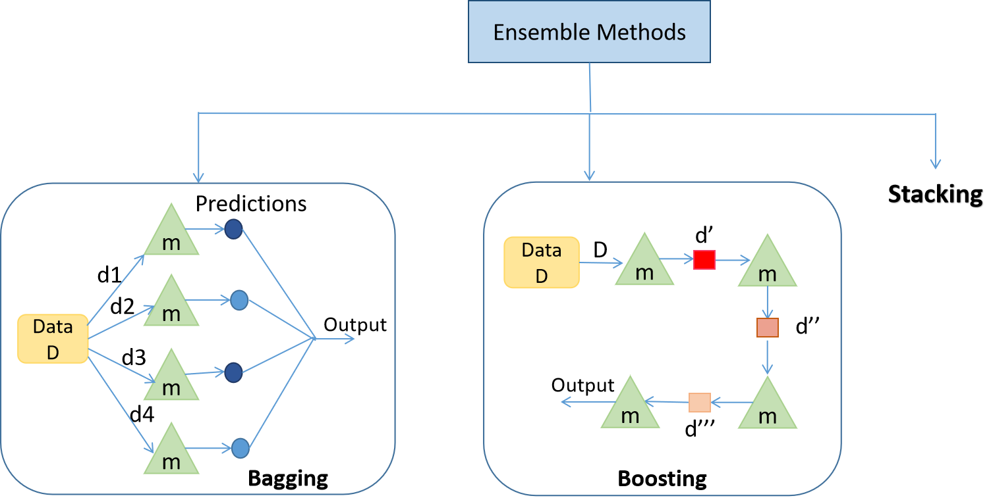
Random forest Regression
Random forest regression is an ensemble learning algorithm that combines multiple decision trees to create a more accurate and robust model.
Each decision tree is constructed using a random subset of the training data and a random subset of the input features.
This helps to reduce the risk of overfitting, as each tree is trained on a slightly different subset of the data.

Slide 8
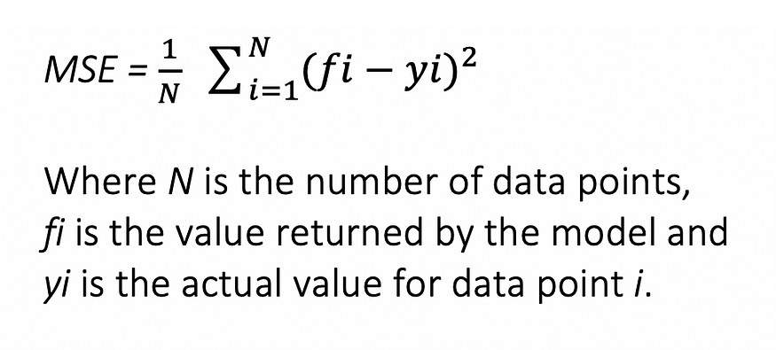
Mathematical Understanding
When using the Random Forest Algorithm to solve regression problems, you are using the mean squared error (MSE) to how your data branches from each node.
This formula calculates the distance of each node from the predicted actual value, helping to decide which branch is the better decision for your forest.
Here, yi is the value of the data point you are testing at a certain node and fi is the value returned by the decision tree.

Slide 9
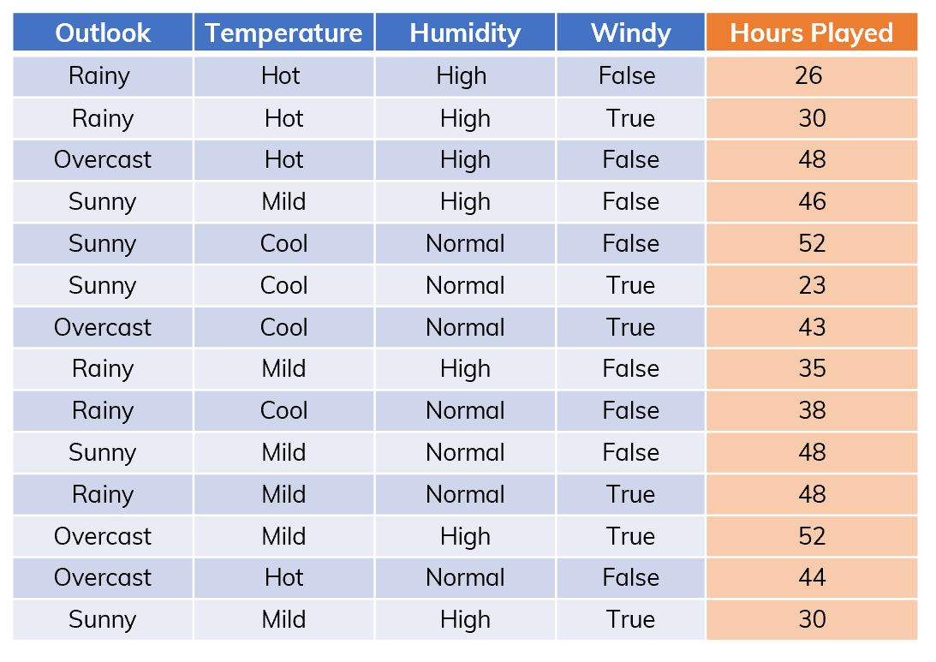
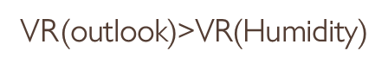
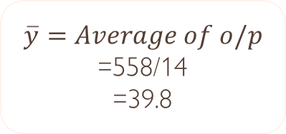
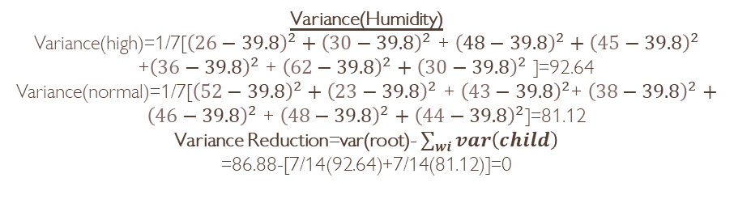
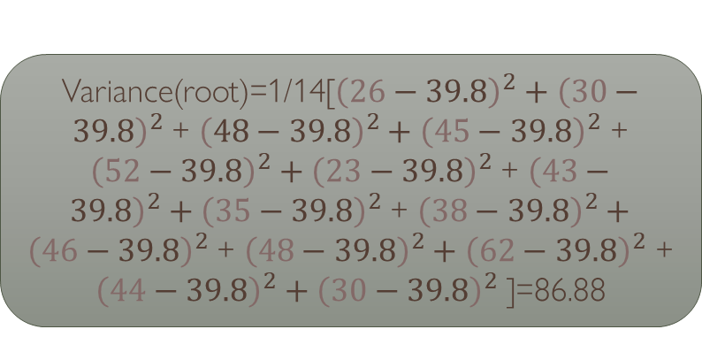
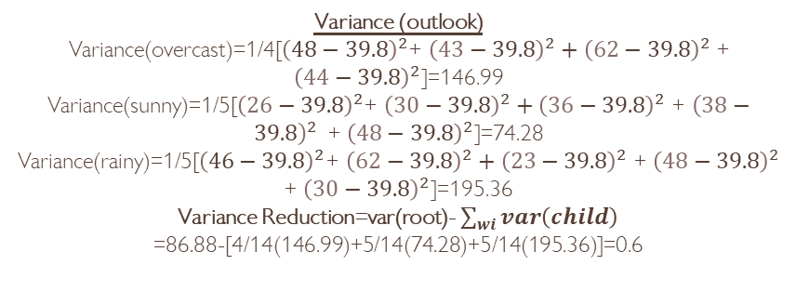
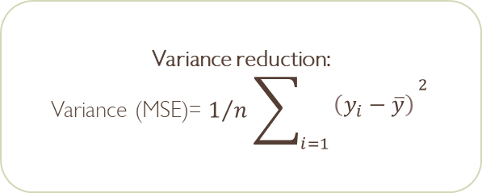
Variance(root)=1/14[${\left(26−39.8\right)}^{2}+{\left(30−39.8\right)}^{2}$ + ${\left(48−39.8\right)}^{2}+{\left(45−39.8\right)}^{2}$ + ${\left(52−39.8\right)}^{2}+{\left(23−39.8\right)}^{2}$ + ${\left(43−39.8\right)}^{2}+{\left(35−39.8\right)}^{2}$ + ${\left(38−39.8\right)}^{2}+{\left(46−39.8\right)}^{2}$ + ${\left(48−39.8\right)}^{2}+{\left(62−39.8\right)}^{2}$ + ${\left(44−39.8\right)}^{2}+{\left(30−39.8\right)}^{2}$ ]=86.88
Variance (outlook)
Variance(overcast)=1/4[${\left(48−39.8\right)}^{2}$+ ${\left(43−39.8\right)}^{2}+{\left(62−39.8\right)}^{2}$ + ${\left(44−39.8\right)}^{2}$]=146.99
Variance(sunny)=1/5[${\left(26−39.8\right)}^{2}$+ ${\left(30−39.8\right)}^{2}+{\left(36−39.8\right)}^{2}$ + ${\left(38−39.8\right)}^{2 }$ + ${\left(48−39.8\right)}^{2}$]=74.28
Variance(rainy)=1/5[${\left(46−39.8\right)}^{2}$+ ${\left(62−39.8\right)}^{2}+{\left(23−39.8\right)}^{2}$ + ${\left(48−39.8\right)}^{2}$ + ${\left(30−39.8\right)}^{2}$]=195.36
Variance Reduction=var(root)- $\sum_{wi}{var\left(child\right)}$
=86.88-[4/14(146.99)+5/14(74.28)+5/14(195.36)]=0.6
Outlook
Humidity
overcast
Rainy
Sunny
High
Normal
Variance(Humidity)
Variance(high)=1/7[${\left(26−39.8\right)}^{2}+{\left(30−39.8\right)}^{2}$ + ${\left(48−39.8\right)}^{2}+{\left(45−39.8\right)}^{2}$ +${\left(36−39.8\right)}^{2}$ + ${\left(62−39.8\right)}^{2}+{\left(30−39.8\right)}^{2}$ ]=92.64
Variance(normal)=1/7[${\left(52−39.8\right)}^{2}+{\left(23−39.8\right)}^{2}$ + ${\left(43−39.8\right)}^{2}$+ ${\left(38−39.8\right)}^{2}+{\left(46−39.8\right)}^{2}$ + ${\left(48−39.8\right)}^{2}+{\left(44−39.8\right)}^{2}$]=81.12
Variance Reduction=var(root)- $\sum_{wi}{var\left(child\right)}$
=86.88-[7/14(92.64)+7/14(81.12)]=0
48,43,62,44
26,30,36,38,48
46,62,23,48,30
26,30,48,45,36,62,30
62,23,43,38,48,48,44
Variance reduction:
Variance (MSE)= $1/n\sum_{i=1}{\begin{aligned}{\left(y_{i}−\overline{y}\right)}^{\begin{aligned}2 \\ \end{aligned}} \\ \end{aligned}}$
$$\overline{y}=Average of o/p$$
=558/14
=39.8

Slide 10
Hyper parameters & terminologies
Leaf Node :A leaf node is a node that carries the decision.
Decision Node : A node that has two or more branches.
Root Node : The root node is the topmost decision node, which is where you have all of your data.
n_estimators — the number of decision trees you will be running in the model
max_depth — this sets the maximum possible depth of each tree
max_features — the maximum number of features the model will consider when determining a split
random_state : Controls randomness of the sample.
Components
Hyper parameters

Slide 11
Hyper Parameter Tuning
Using Grid Search CV
Grid Search CV: In this technique, a grid of possible hyperparameter values is created, and a model is trained and tested for each possible combination of hyperparameters. This method is exhaustive and guarantees to find the best hyperparameters in the given grid.
However, it can be computationally expensive, especially when the grid is large.
Using Randomized Search CV
Randomized Search CV: In this technique, instead of trying all possible hyperparameter combinations, a fixed number of random combinations are selected from a range of possible hyperparameters.
This technique is less computationally expensive than Grid Search CV and may perform better in high-dimensional hyperparameter search spaces.
However, there is no guarantee that the optimal hyperparameters will be found, and it may require more iterations to converge to the optimal solution.

Slide 12
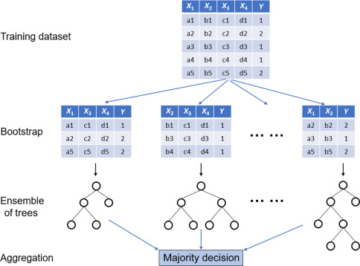
Algorithm working
The following steps explain the working Random Forest Algorithm:
Pick a random K data points from the training set.
Build the decision tree associated to these K data points.
Choose the number N tree of trees you want to build and repeat steps 1 and 2.
For a new data point, make each one of your N-tree trees predict the value of Y for the data point in the question, and assign the new data point the average across all of the predicted Y values.

Slide 13
Tasks - Internship
3rd & 4th week
Build the scratch code for assigned algorithm and implementation
(Boston house price prediction)
1st week
Introduction to the assigned algorithm and its mathematical understanding
2nd week
Coding and implementation using scikit learn libraries
(Boston house price prediction)
Week 7th
Create User interface and Deploy the model using Stream lit app
5th week
Apply my model to other dataset and test the model performance
(Uber data analysis & price prediction)
6th week
Check the model performance for 5 datasets
(Google play store analysis, Suicide prevention, student performance analysis, House price prediction,
Forest fires prediction)

Slide 14

Implementation using scikit-learn
Scikit-learn (Sklearn) is the most useful and robust library for machine learning in Python.
It provides a selection of efficient tools for machine learning and statistical modeling including classification, regression, clustering.
Here are the steps for building your first random forest model using Scikit-Learn:
Set up your environment.
Import libraries and modules.
Load data.
Exploratory data analysis
Data Pre-processing
Split data into training and test sets.
Declare hyperparameters to tune.
Tune model using cross-validation pipeline.

Slide 15
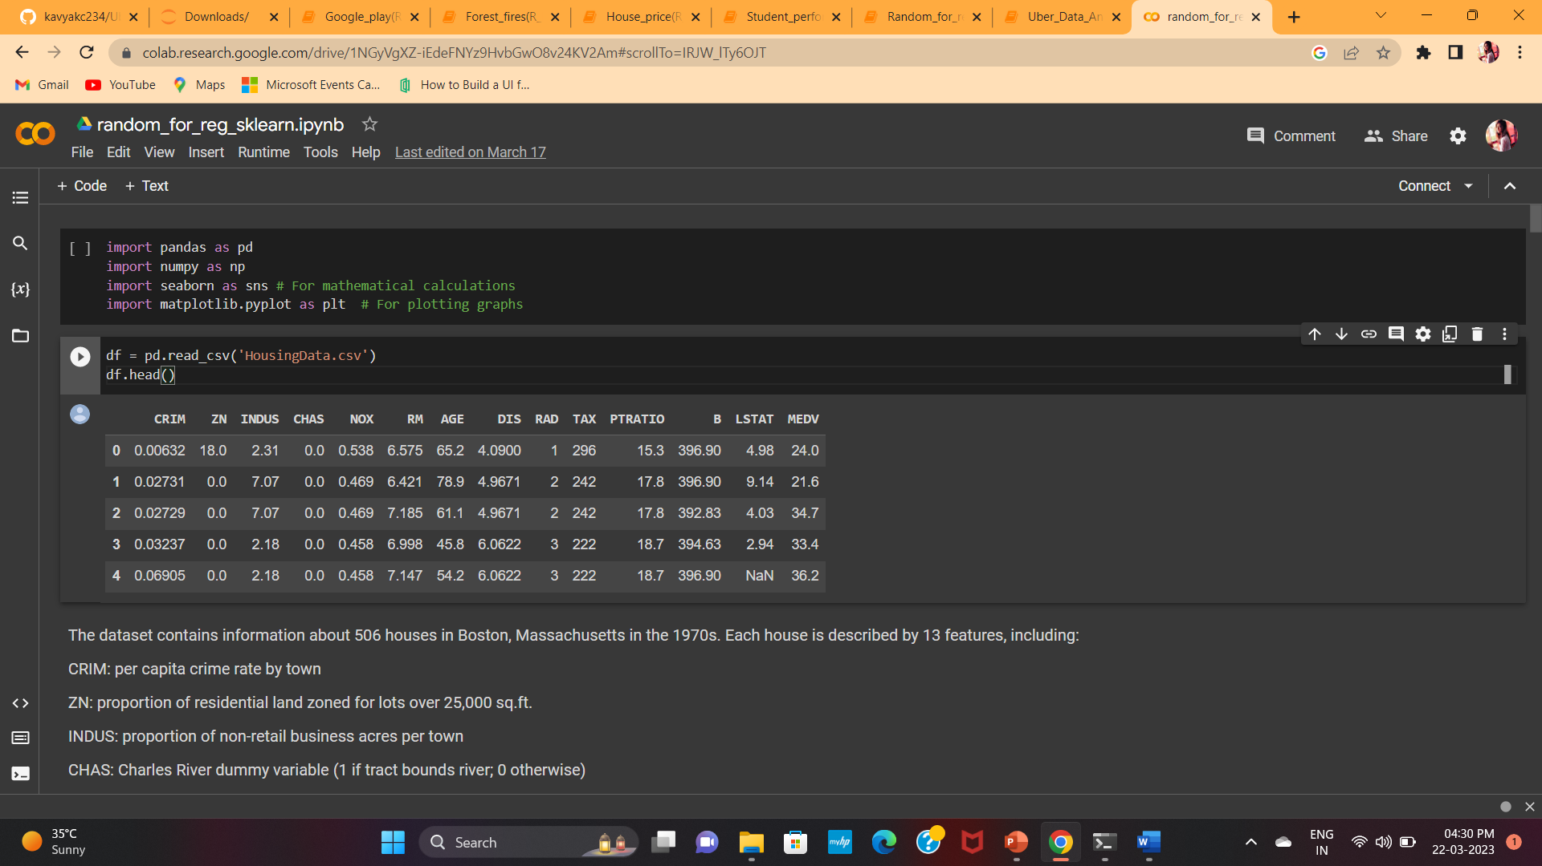
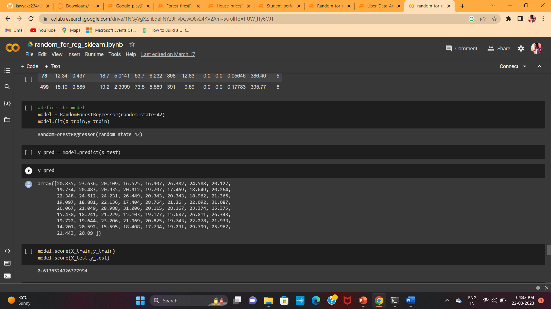
Implementation using scikit-learn
Boston house price prediction
The problem that we are going to solve here is that given a set of features that describe a house in Boston, our machine learning model must predict the house price.
In this dataset, each row describes a boston town or suburb. There are 506 rows and 13 attributes (features) with a target column (price). https://archive.ics.uci.edu/ml/machine-learning-databases/housing/housing.names

Slide 16
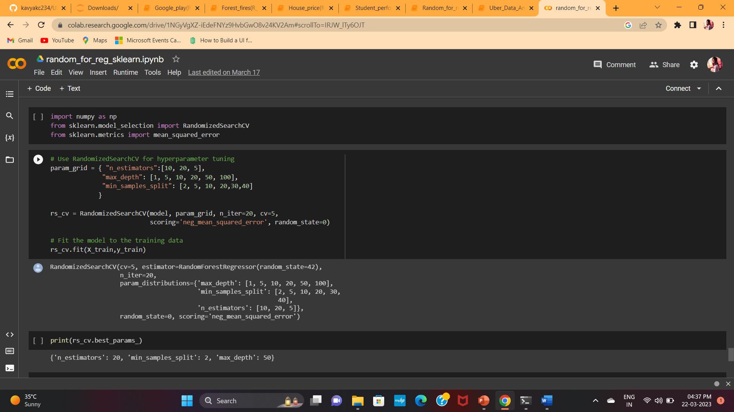
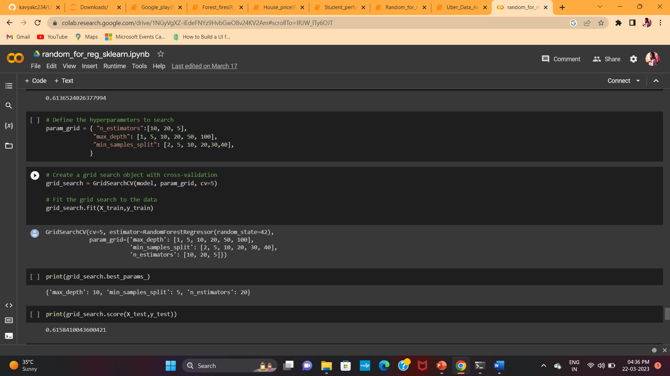
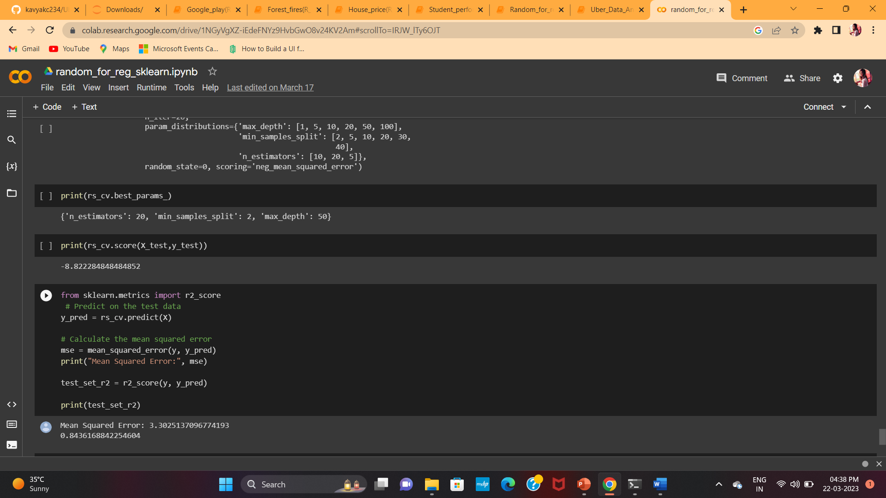
Hyper parameter tuning
Hyper parameter Tuning using Grid search CV and Randomized search CV.

Slide 17
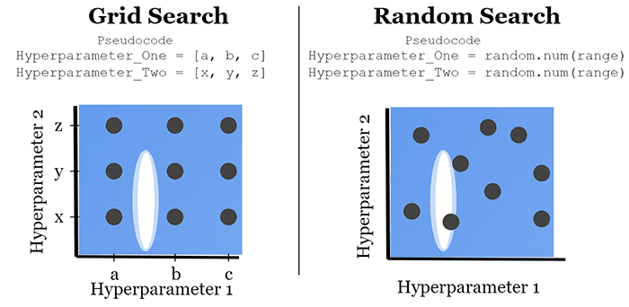
Results
Model(Random Forest regression)score : 0.61365
Model score after tuning(Grid search CV) : 0.6158
MSE after tuning(Randomized Search CV) : 3.302
R2 score : 0.8436

Slide 18
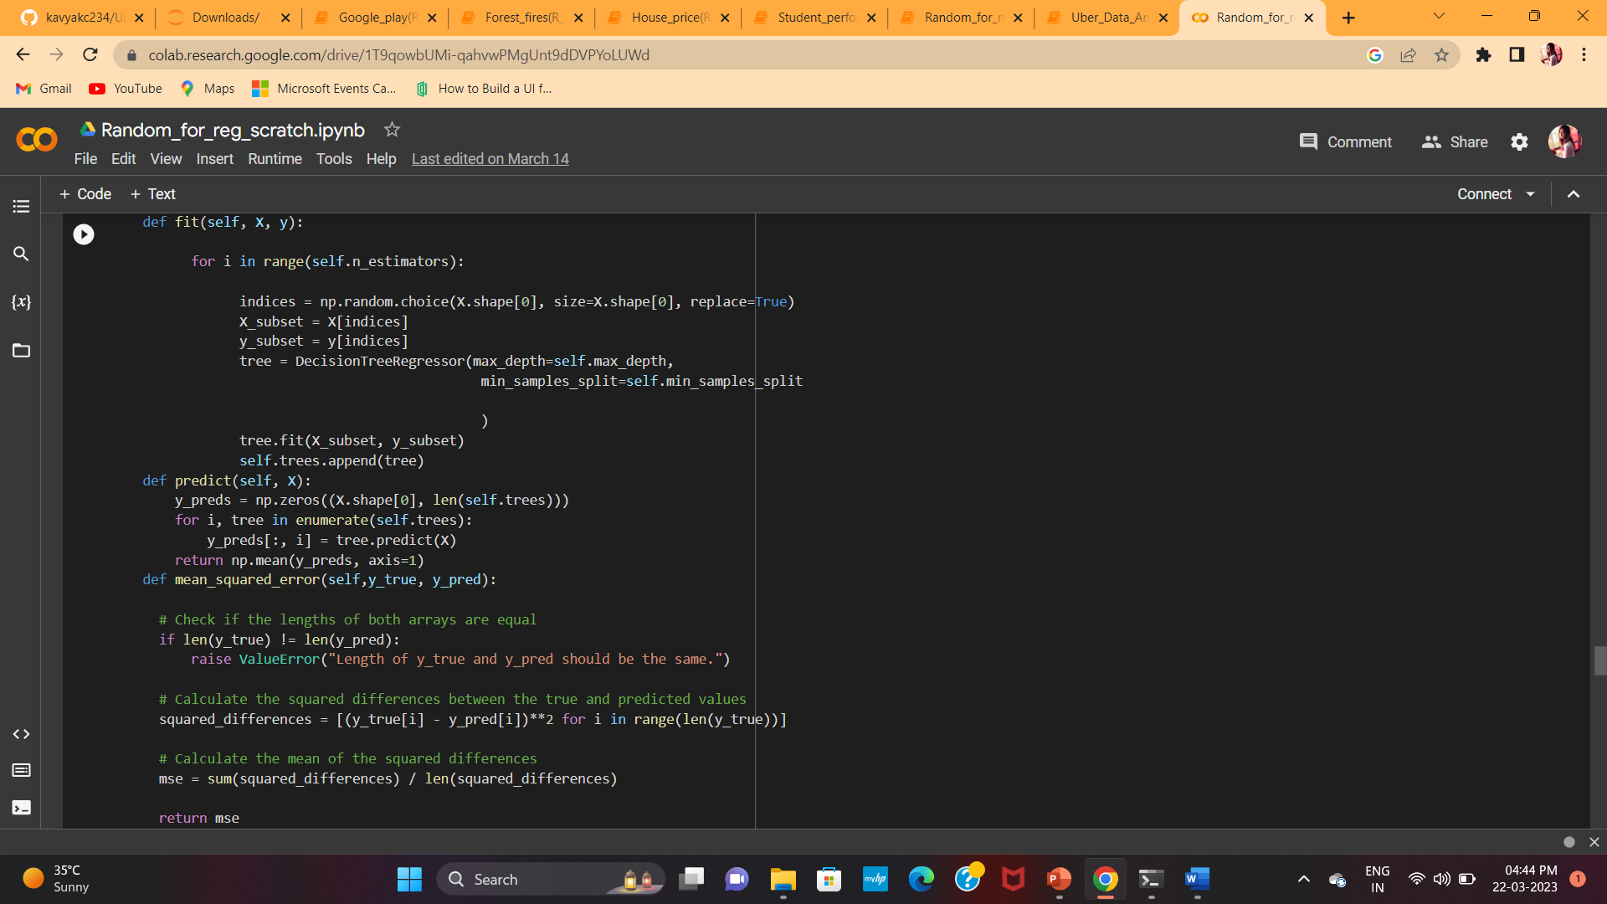
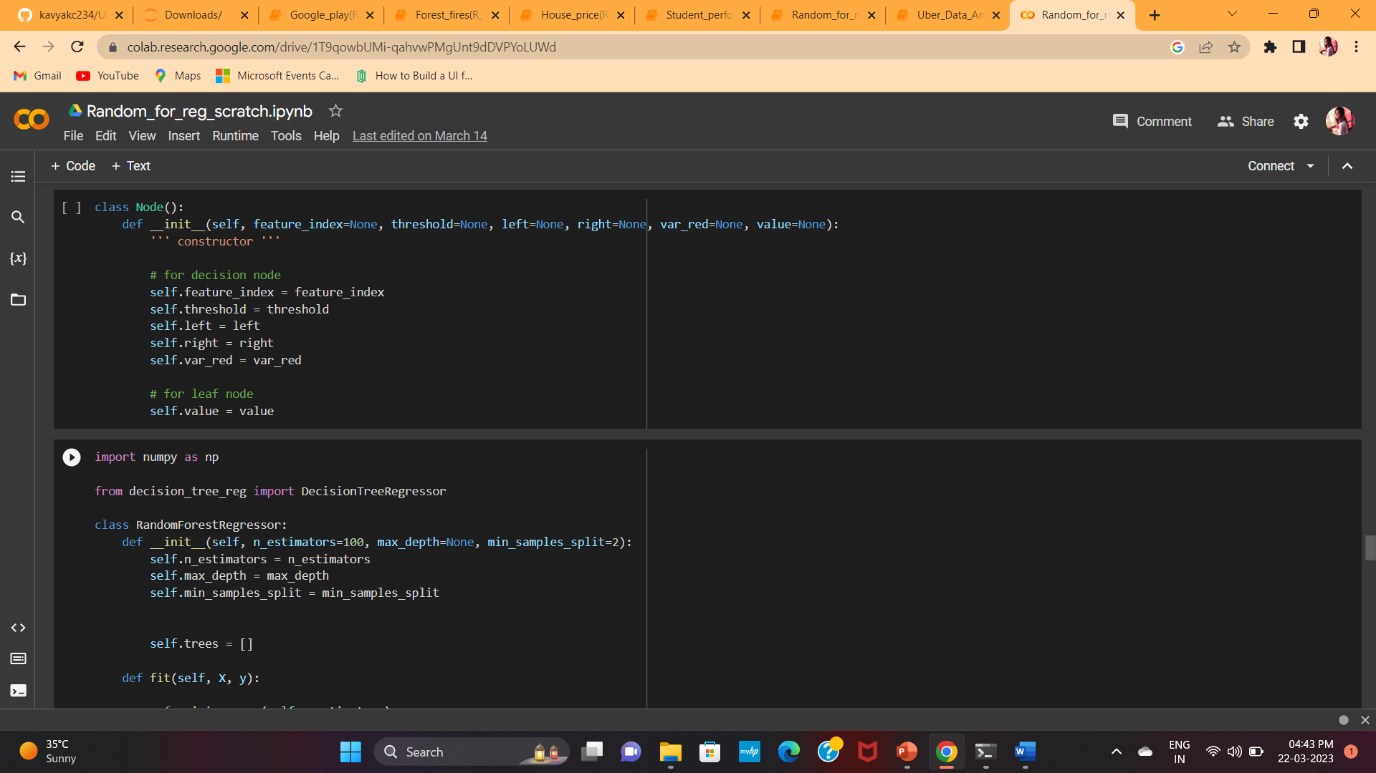
Implementation without using scikit learn libraries
Boston house price prediction
Build the scratch code for Random forest regressor, Decision tree regressor ,Train-Test split, Hyper parameter tuning using Grid search CV and randomized Search CV.

Slide 19
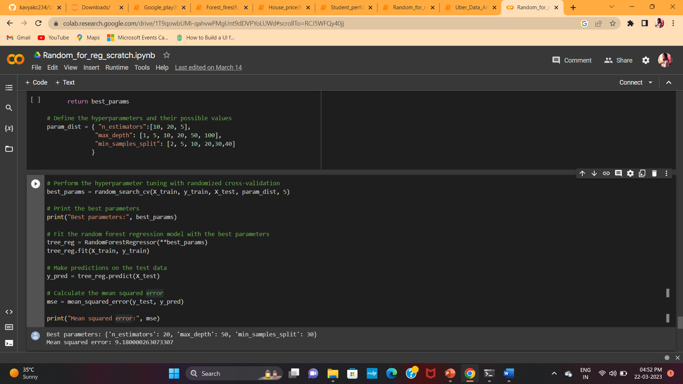
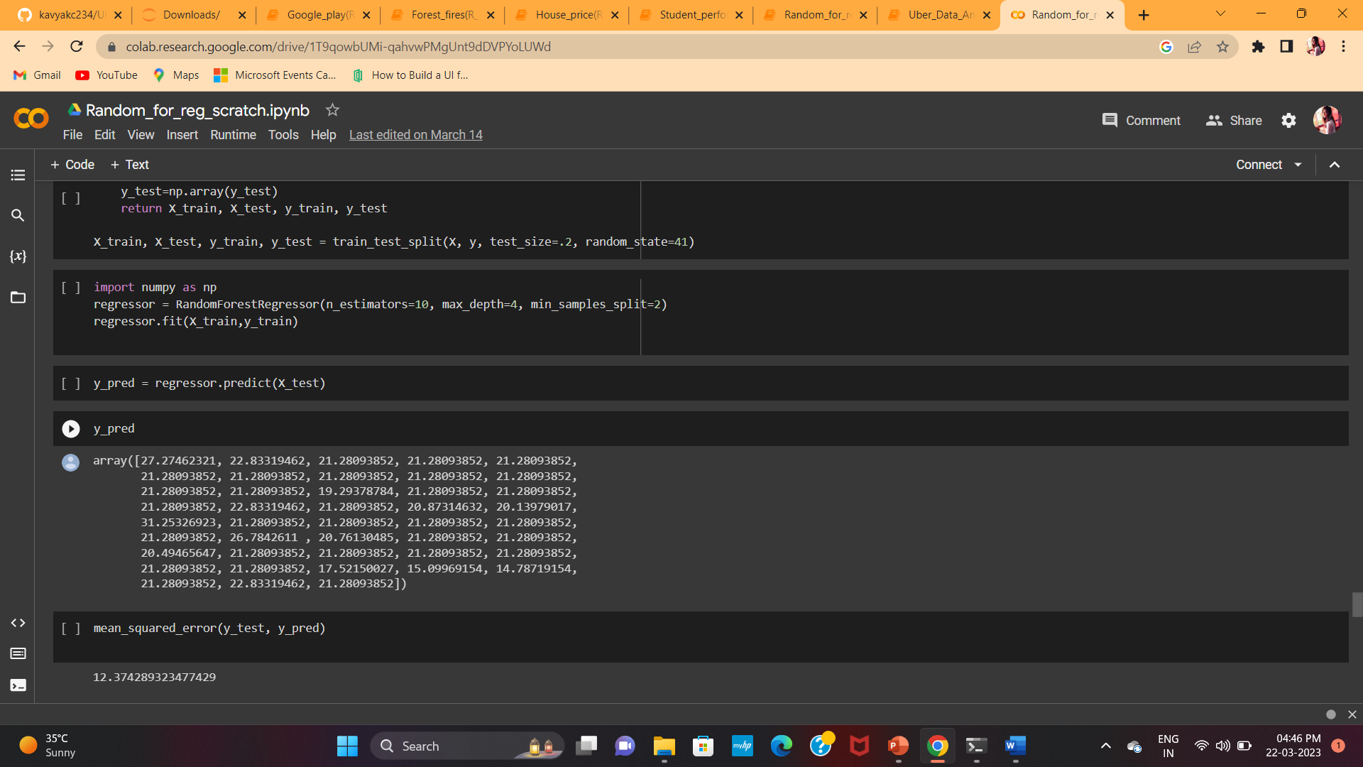
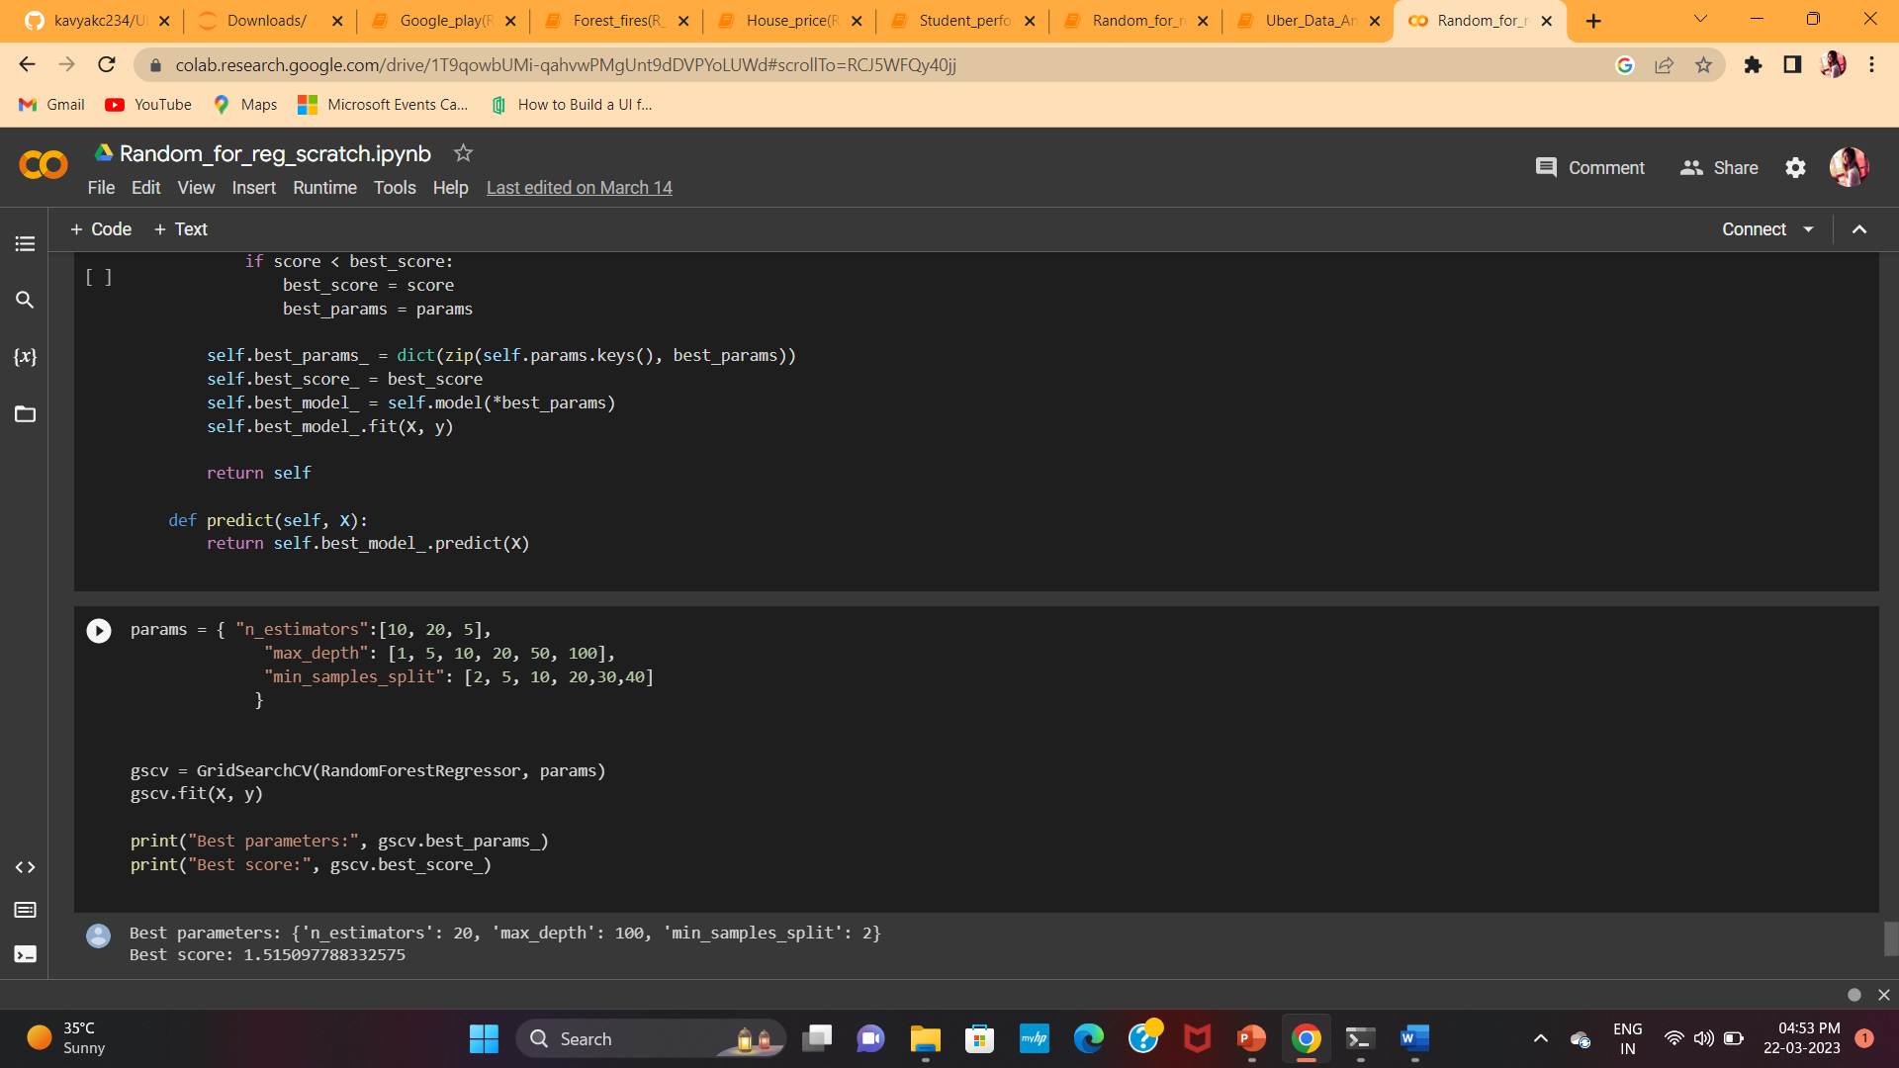
Implementation without using scikit learn libraries

Slide 20
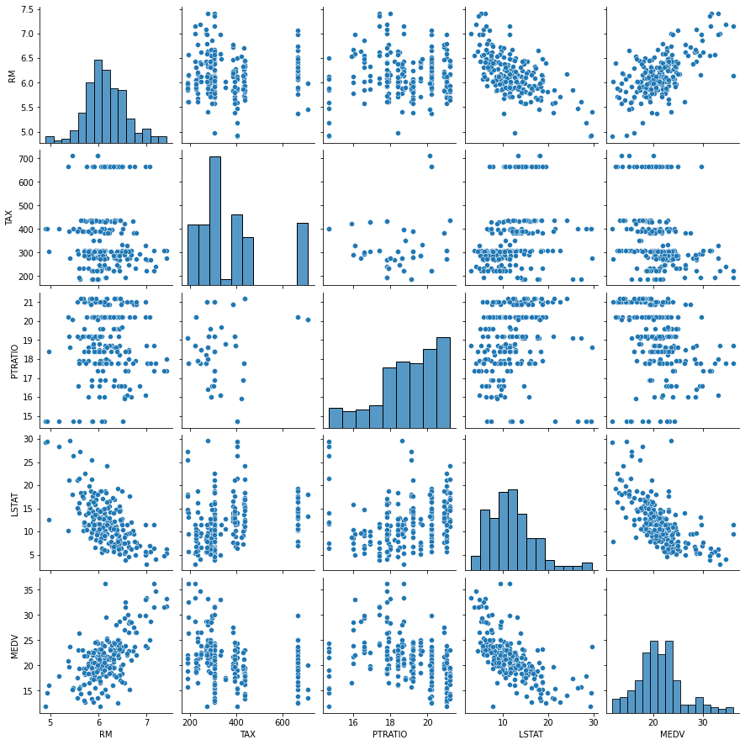
Results
MSE of the built model : 12.37
MSE after Tuning(Randomized search CV) : 9.180
Best score(Grid search CV) : 1.51

Slide 21
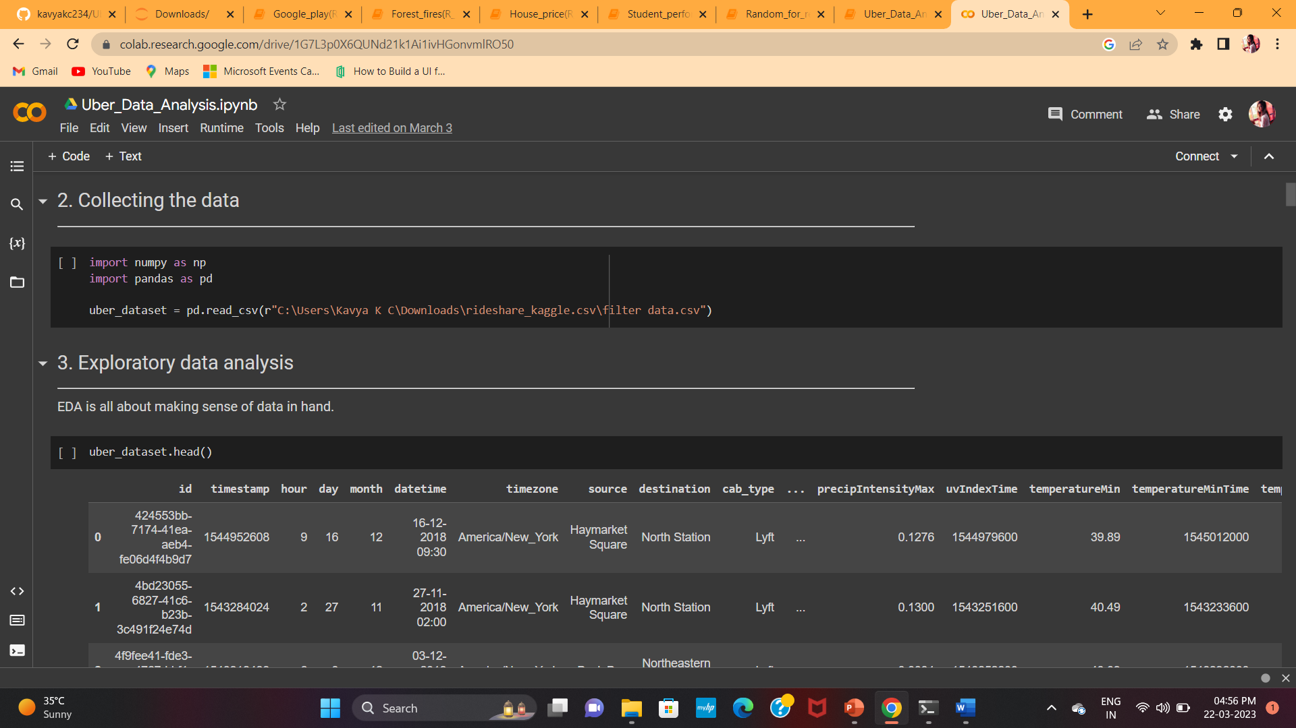
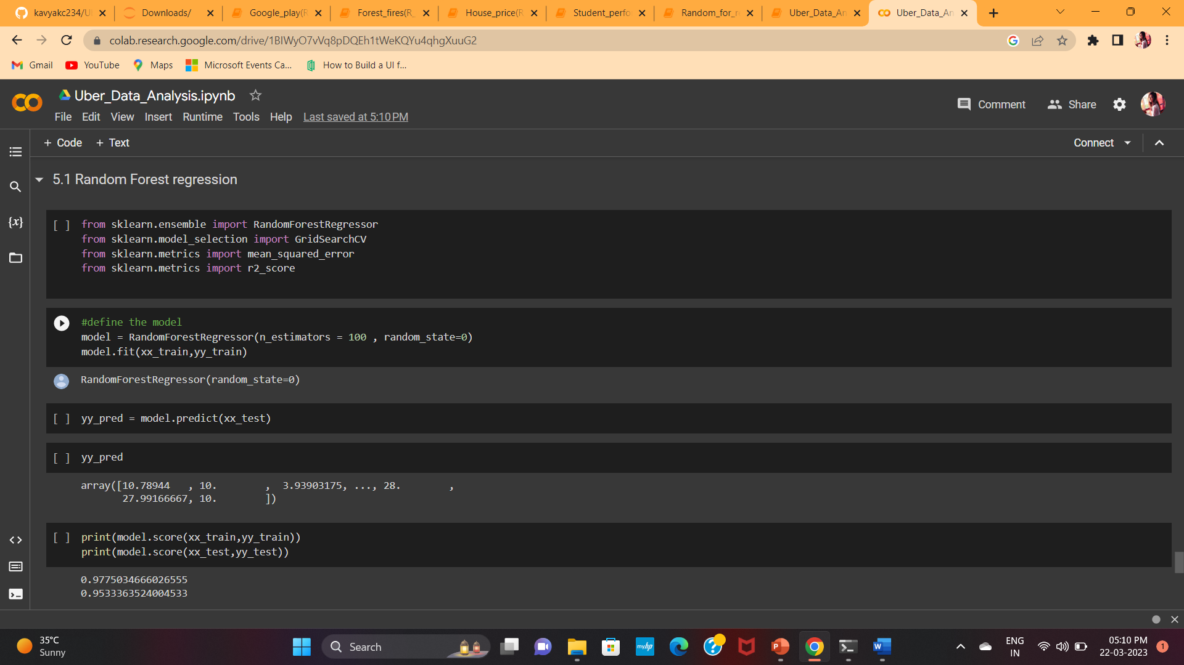
Uber-data analysis
Uber-Data-Analysis
Objective: Complete analysis of dataset and predict the price of uber
DataSet: For this project we are taken the dataset from kaggle in which there are 57 columns and approx 6 lakh rows and the file is in csv format. you can view or download the dataset through this link: https://www.kaggle.com/brllrb/uber-and-lyft-dataset-boston-ma
Application of this Project: We use machine learning algorithms to predict the price of Uber, so that it is easy for the company to do analysis on price based on certain features.

Slide 22
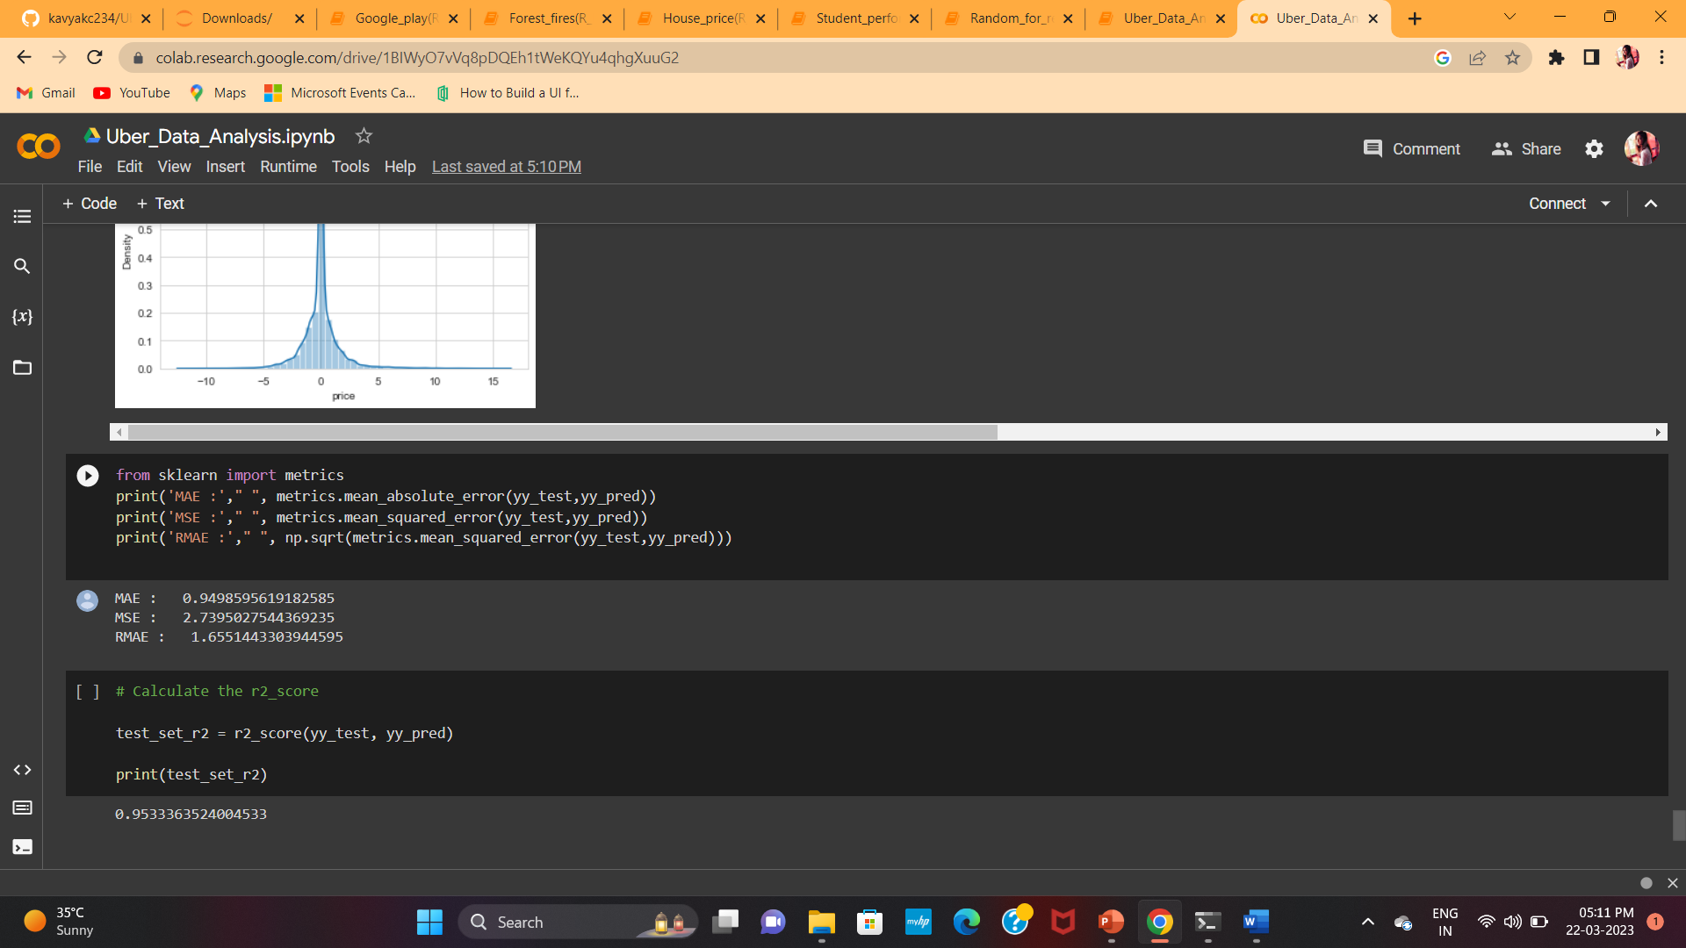
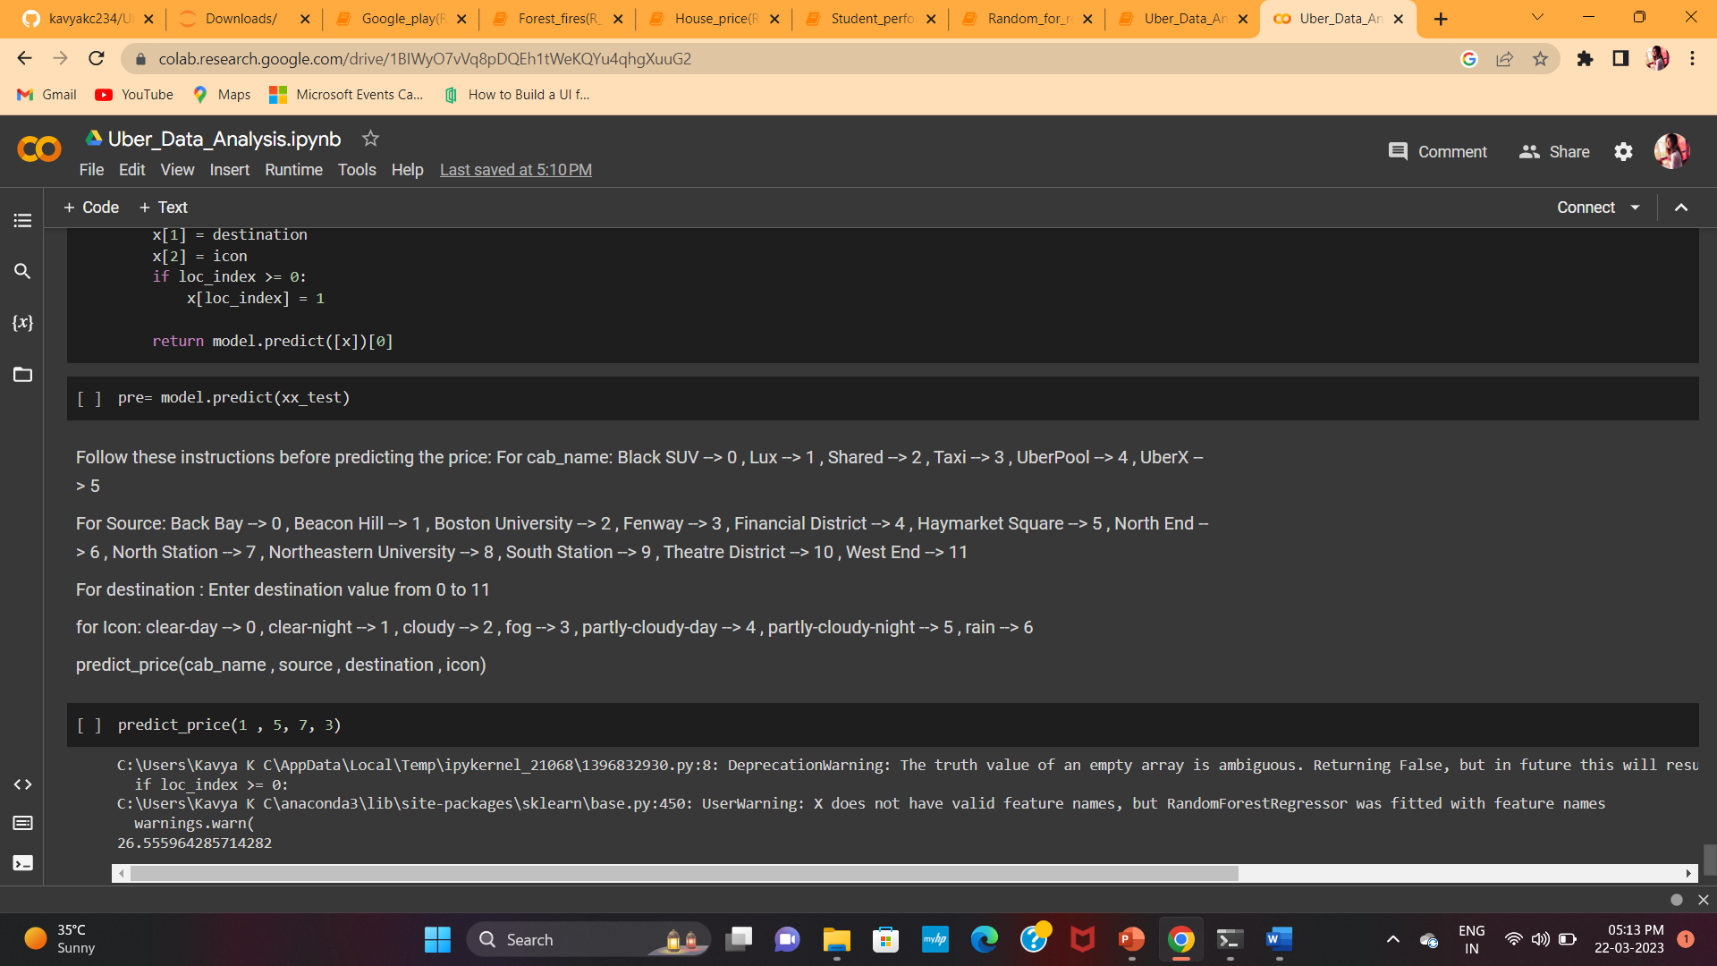
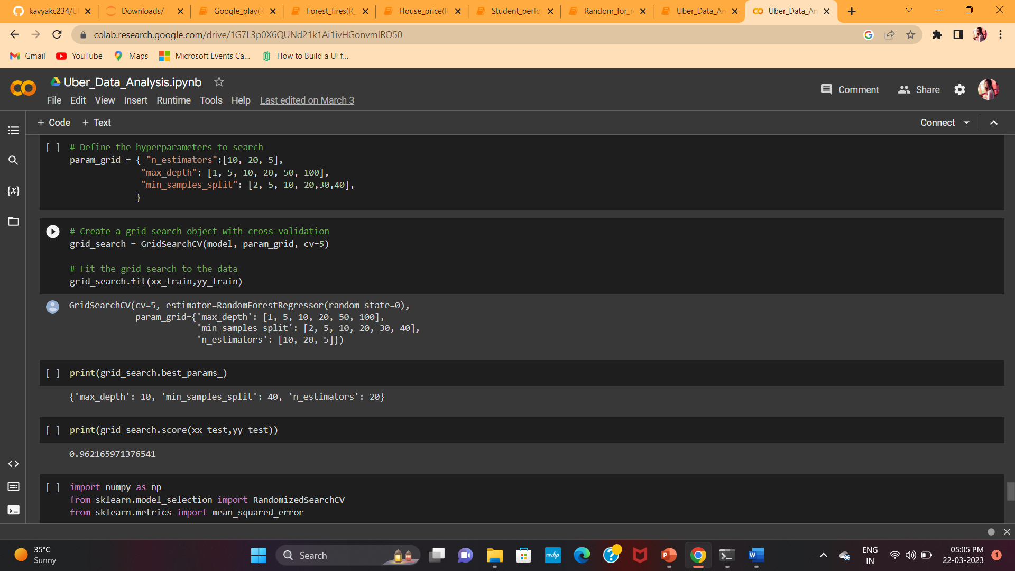
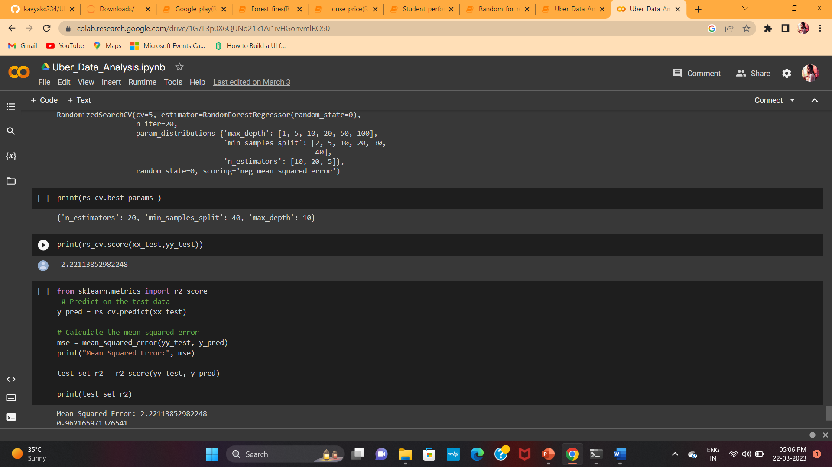
Uber data analysis

Slide 23
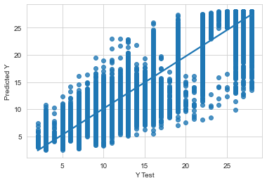
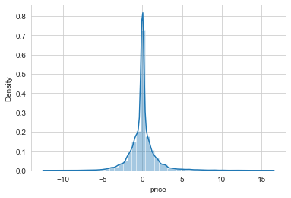
results
Train score : 0.9775
Test score : 0.9553
MSE : 2.739
R2 score : 0.9533
Price : 26.555

Slide 24
EDA & Implementation on 5 Datasets
Google play store analysis
To understand the trend of current google play store market, the best constraints to focus on when launching my first app
Student performance analysis
To predict students final performance classification
Kc house Data analysis
We have to predict the sales price of houses in king county, seattle.
Forest fires data analysis
Predict the burned area of forest fires, in the northeast region of portugal, by using meteorological and other data.
Suicide analysis
Suicide prevention

Slide 25
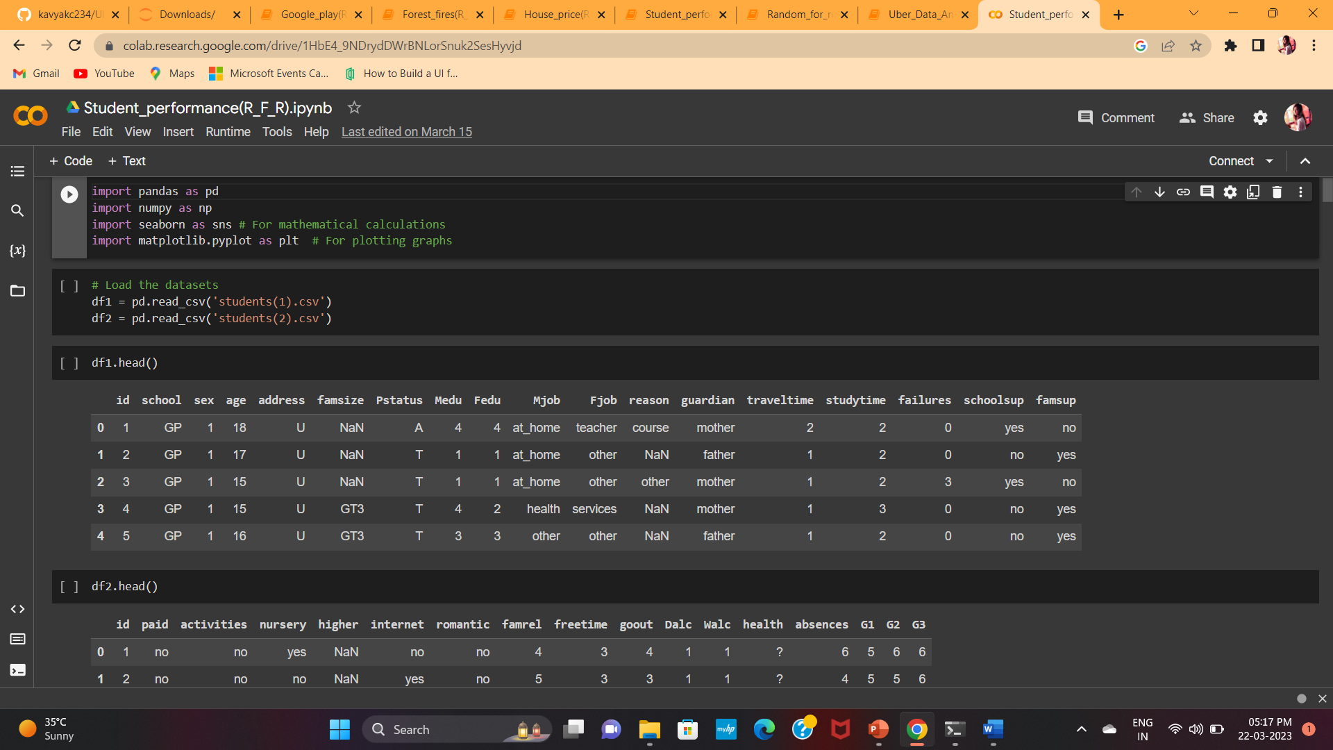
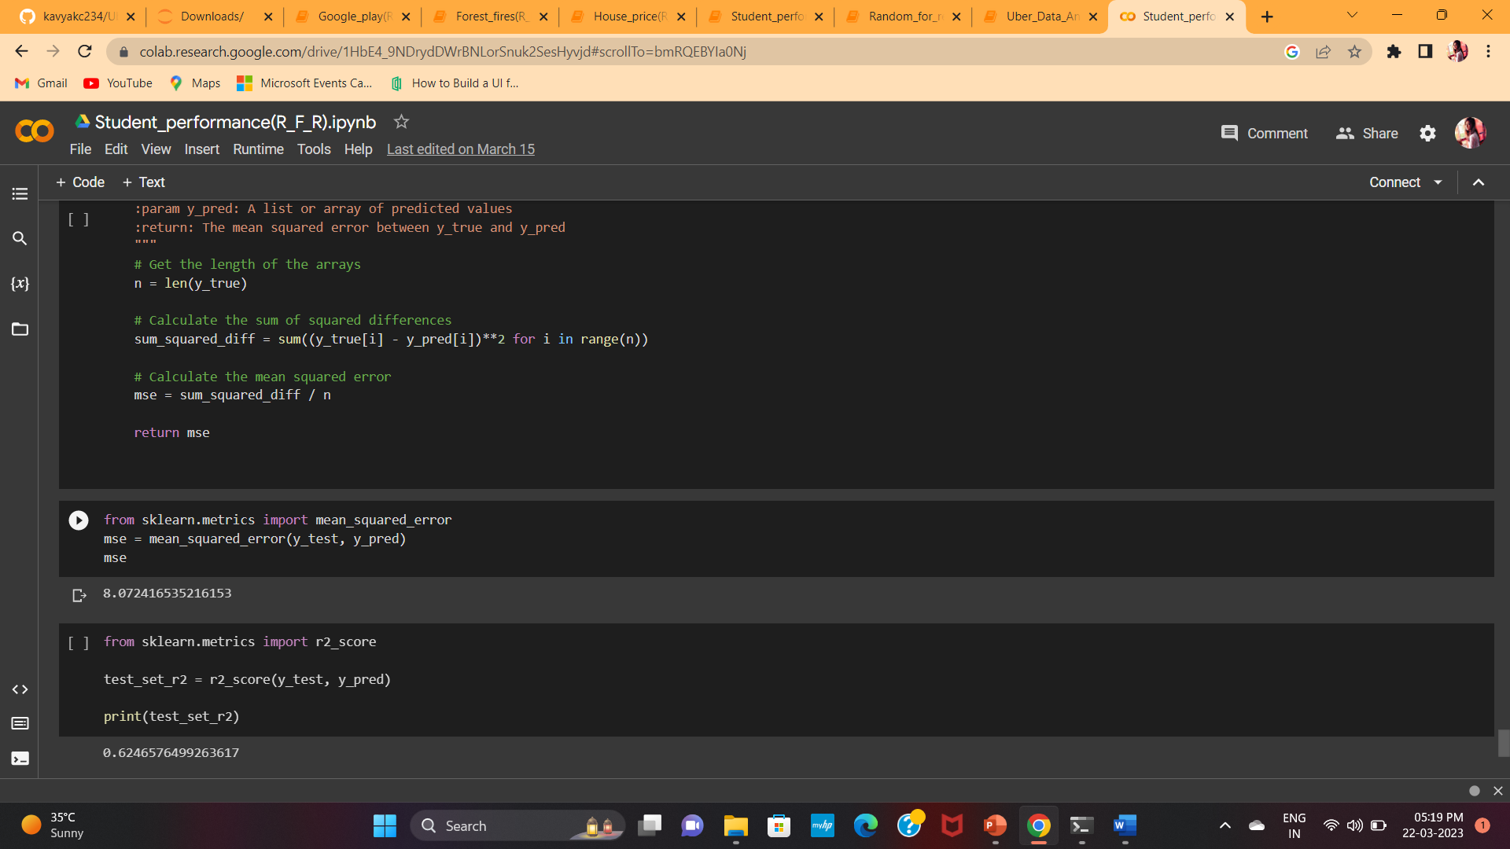
Student performance analysis
This data approach student achievement in secondary education of two Portuguese schools. The data attributes include student grades, demographic, social and school related features and it was collected by using school reports and questionnaires.
Two datasets are provided regarding the performance in two distinct subjects: Mathematics (mat) and Portuguese language (por).
ATTRIBUTES INFO: Attributes for both student-mat.csv (Math course) and student-por.csv (Portuguese language course).

Slide 26
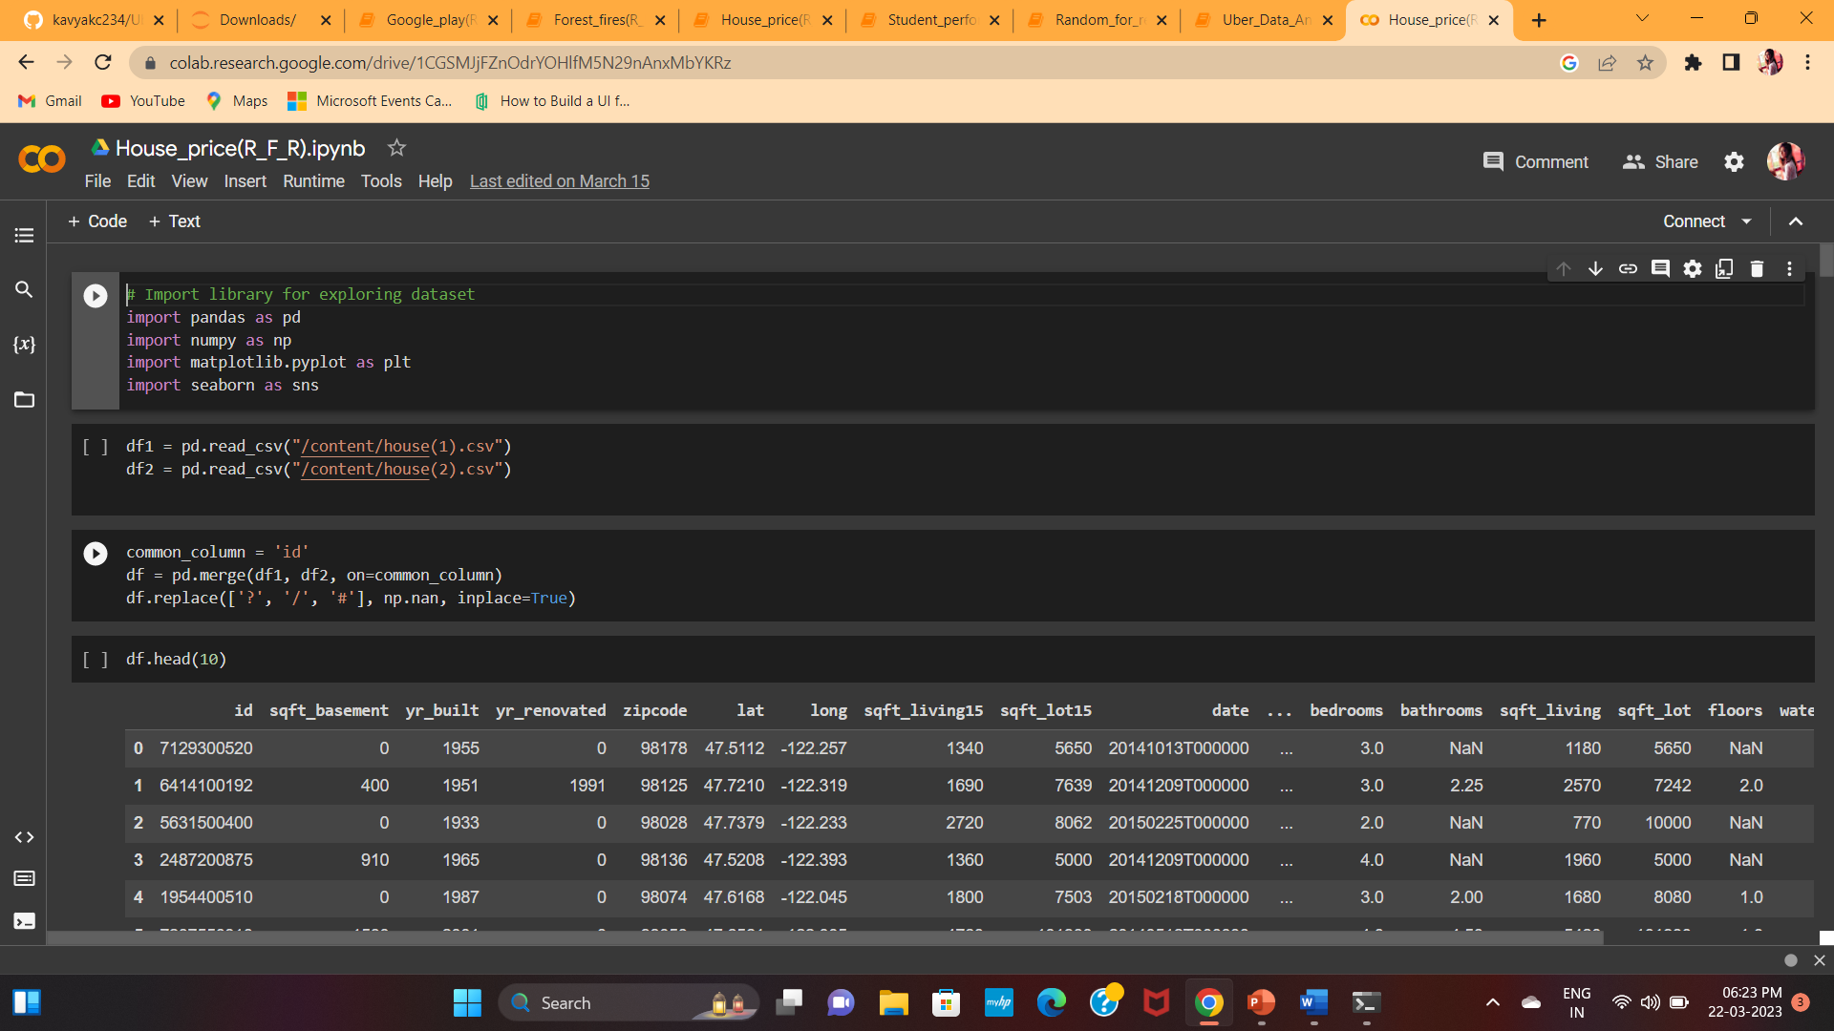
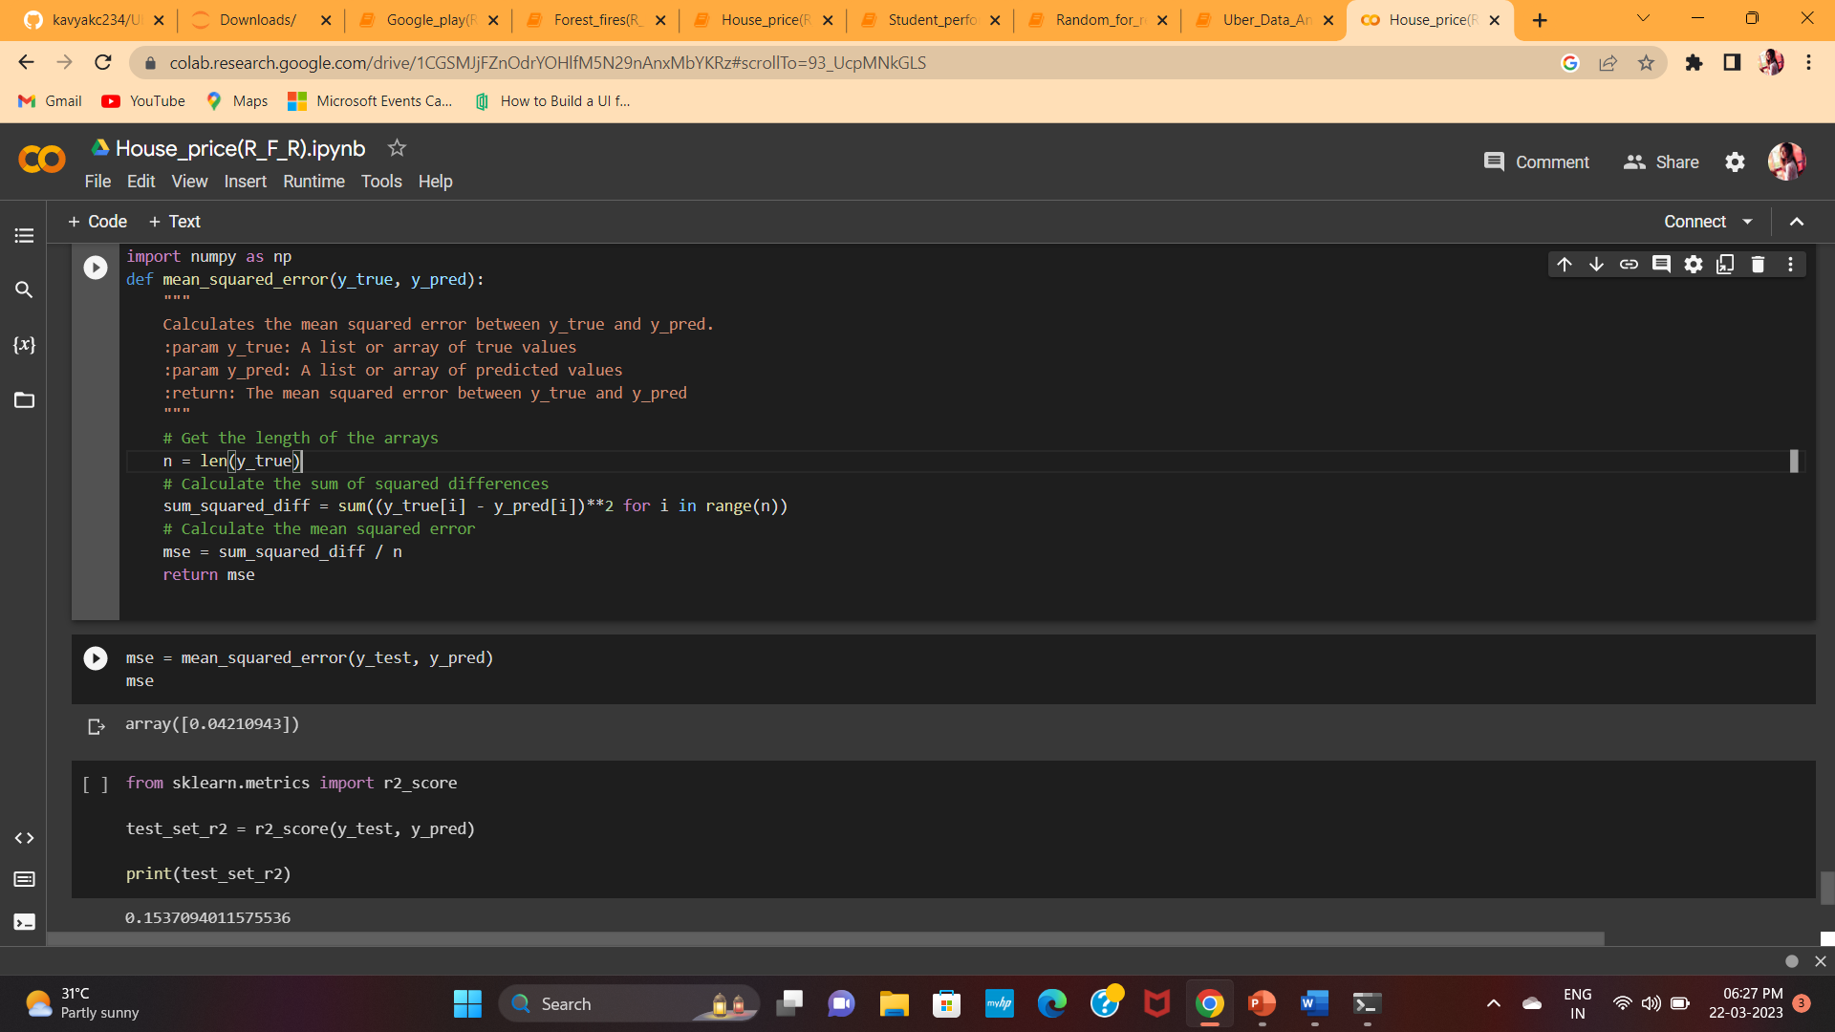
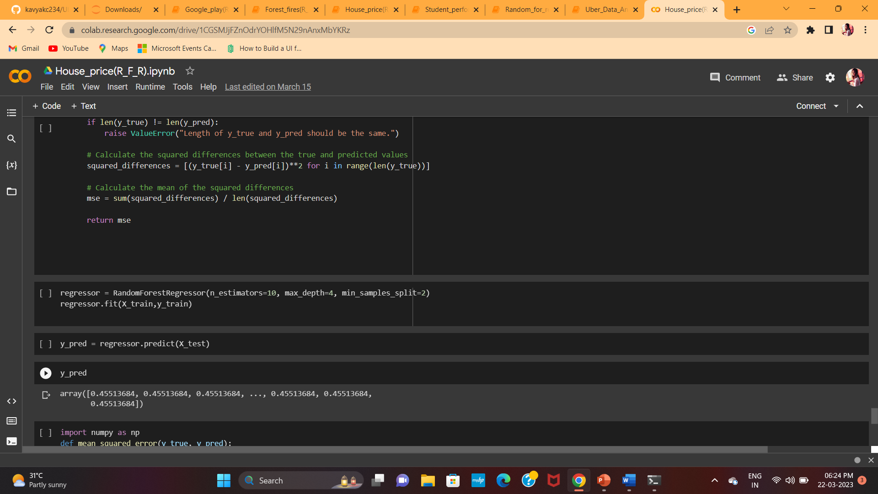
Kc House data analysis
This dataset contains house sale prices for King County, which includes Seattle. It includes homes sold between May 2014 and May 2015.

Slide 27
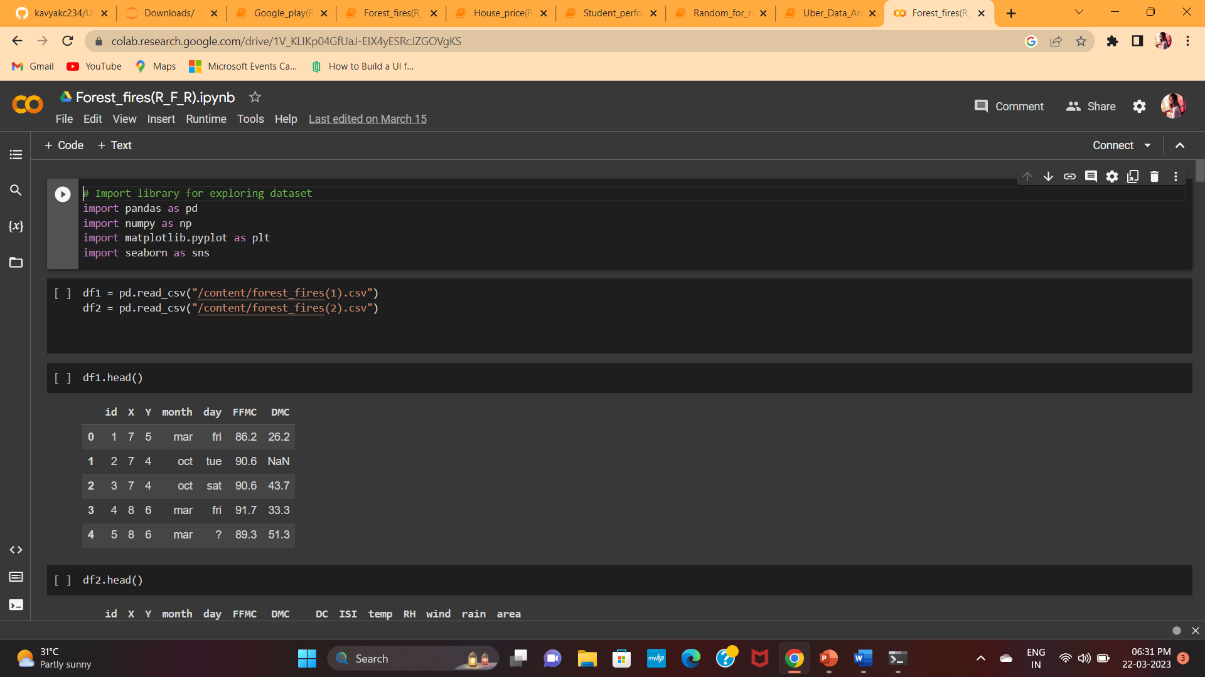
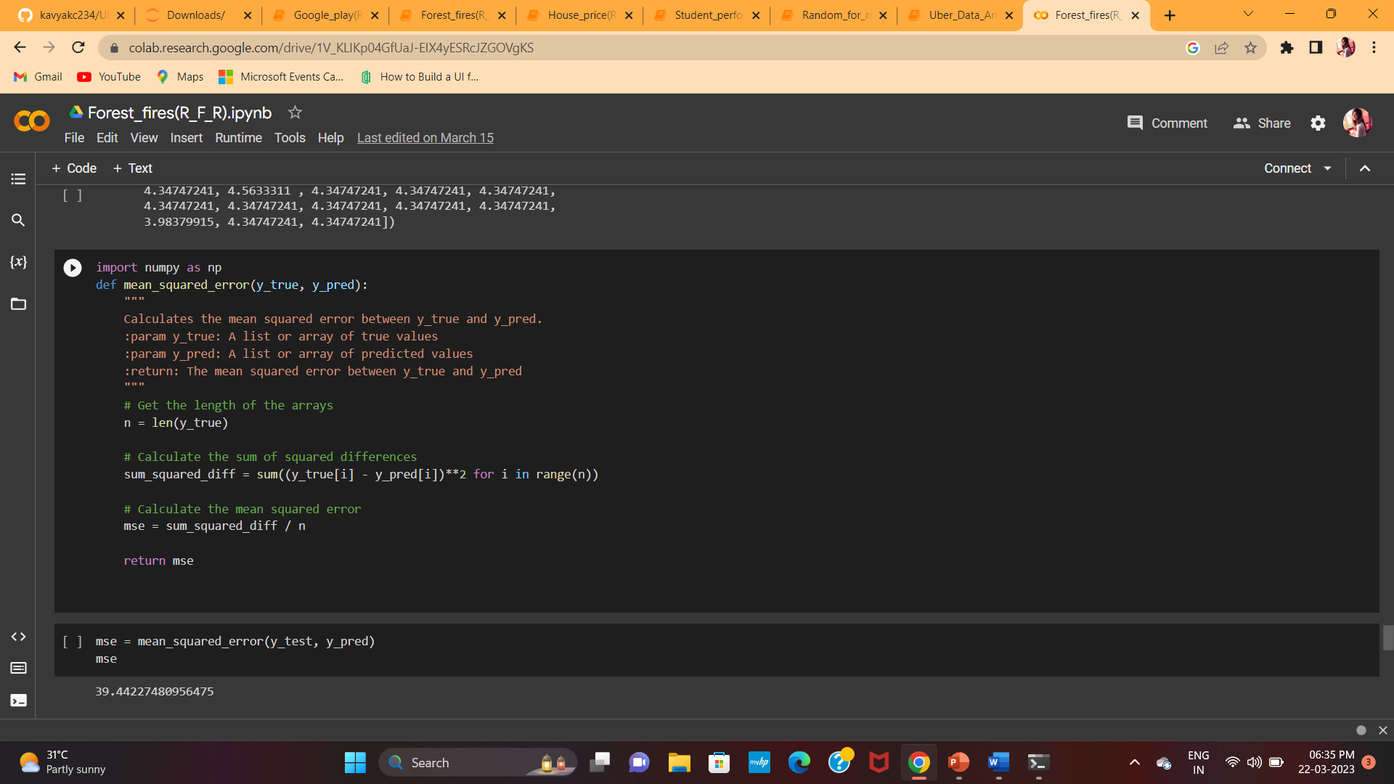
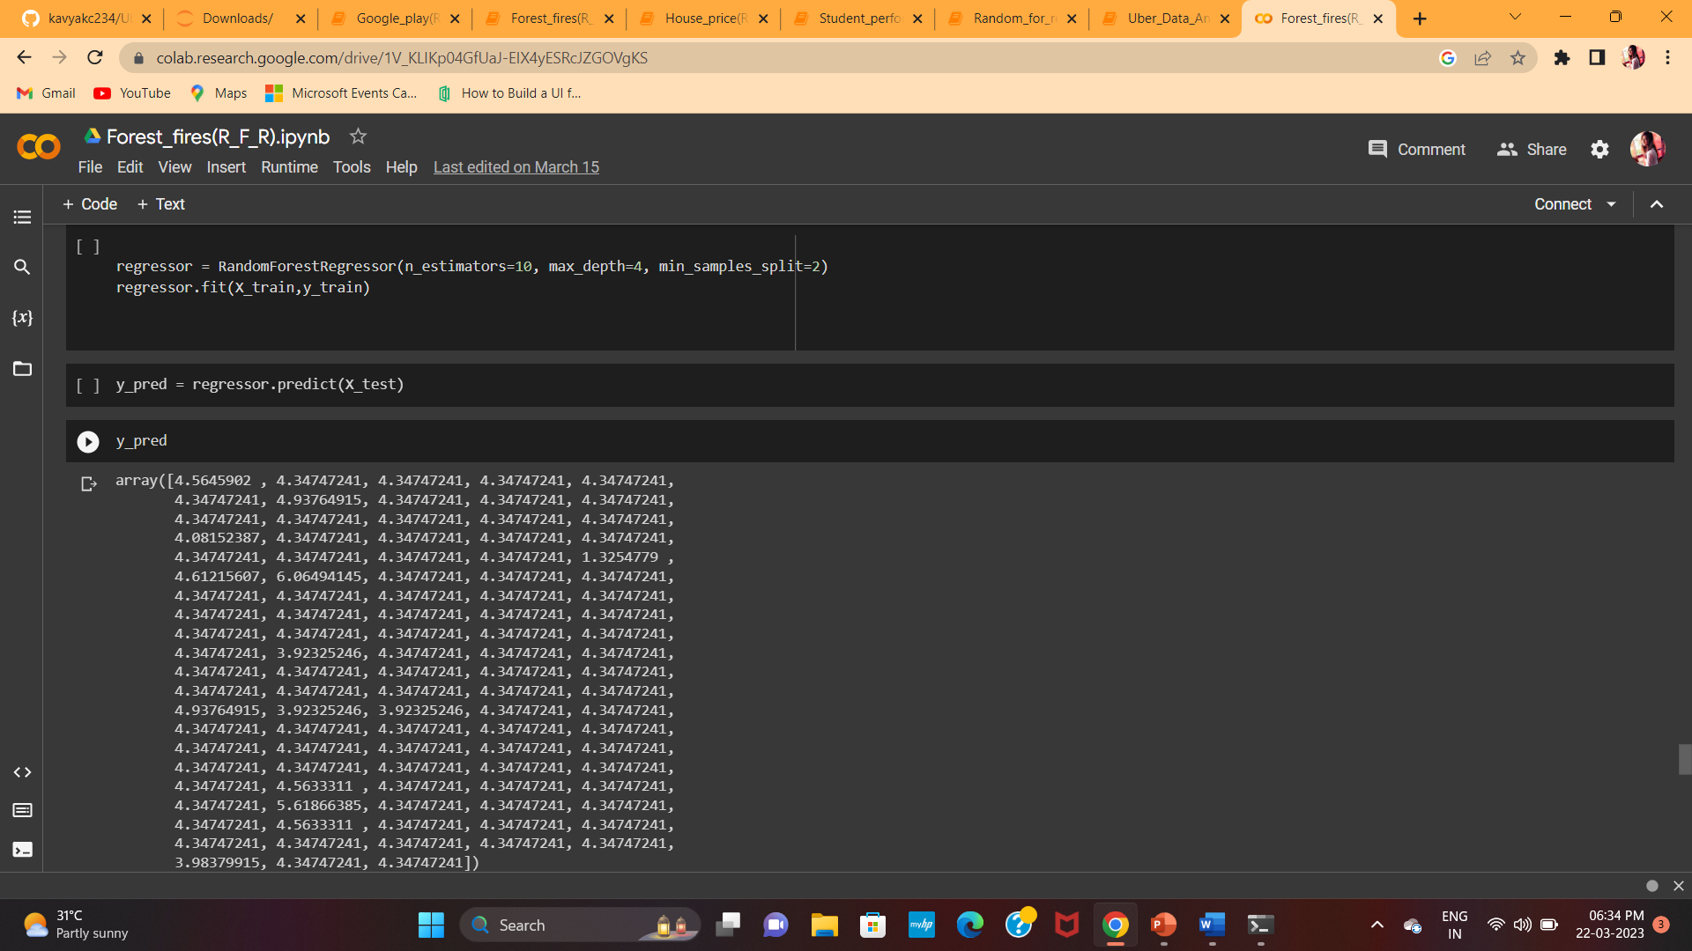
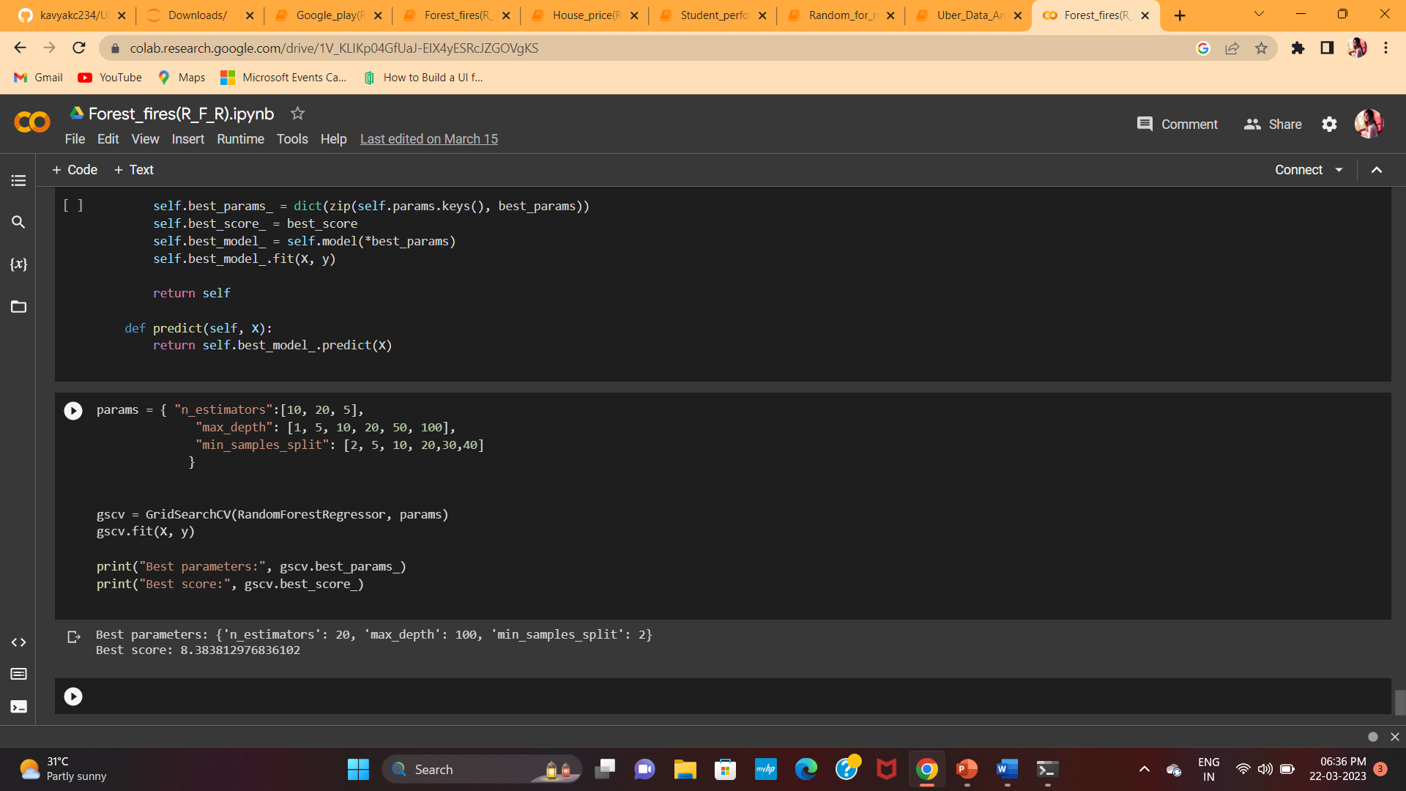
Forest fires data analysis
This is a difficult regression task, where the aim is to predict the burned area of forest fires, in the northeast region of Portugal, by using meteorological and other data. Collected from UCI ML repository.

Slide 28
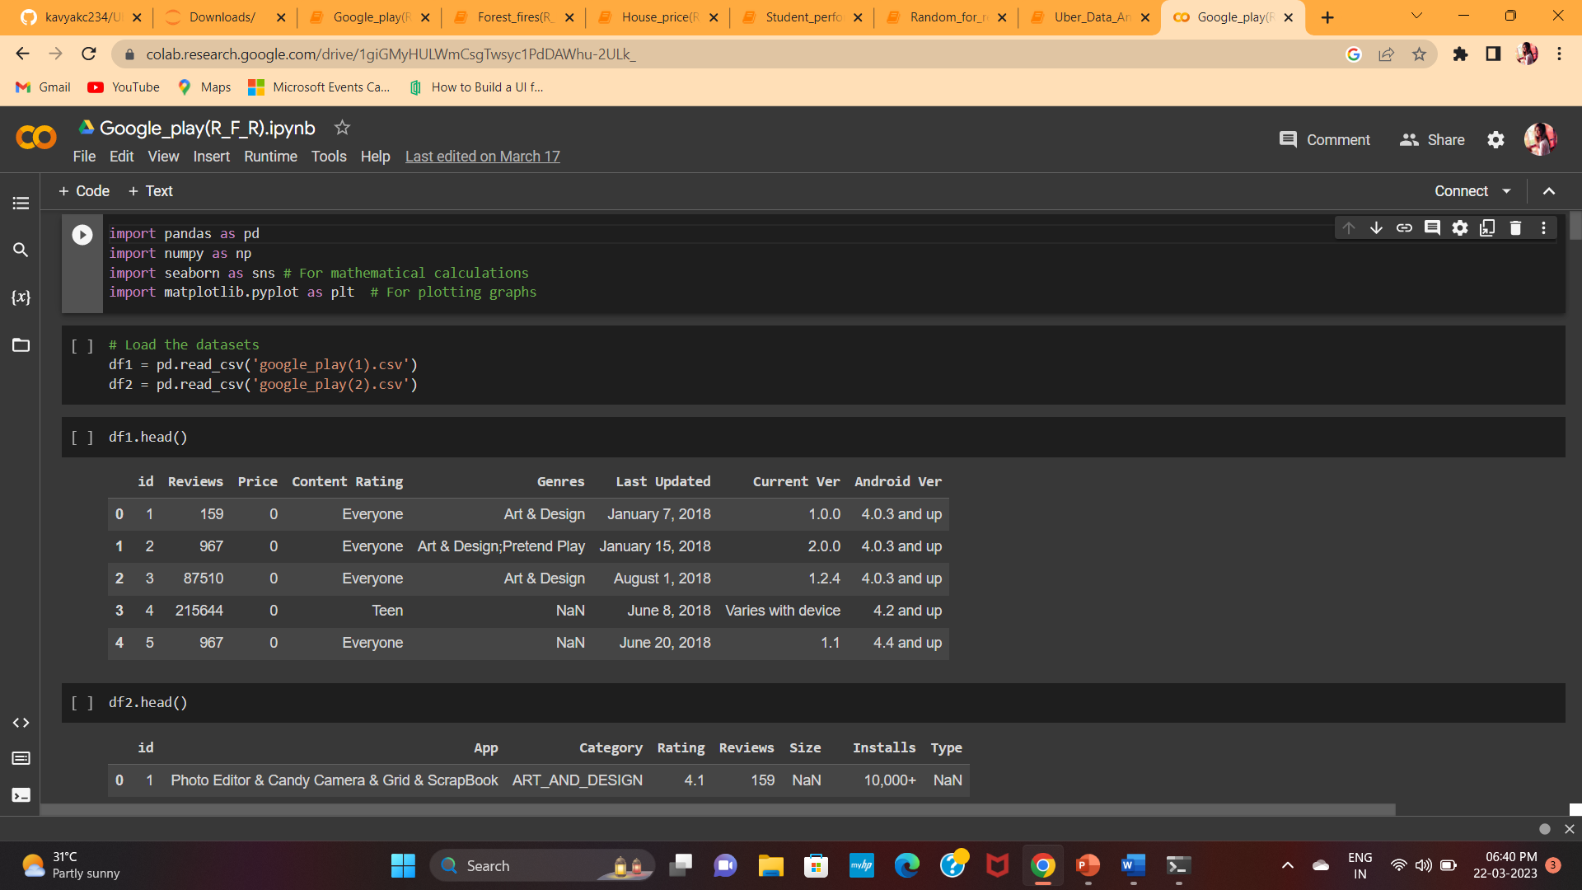
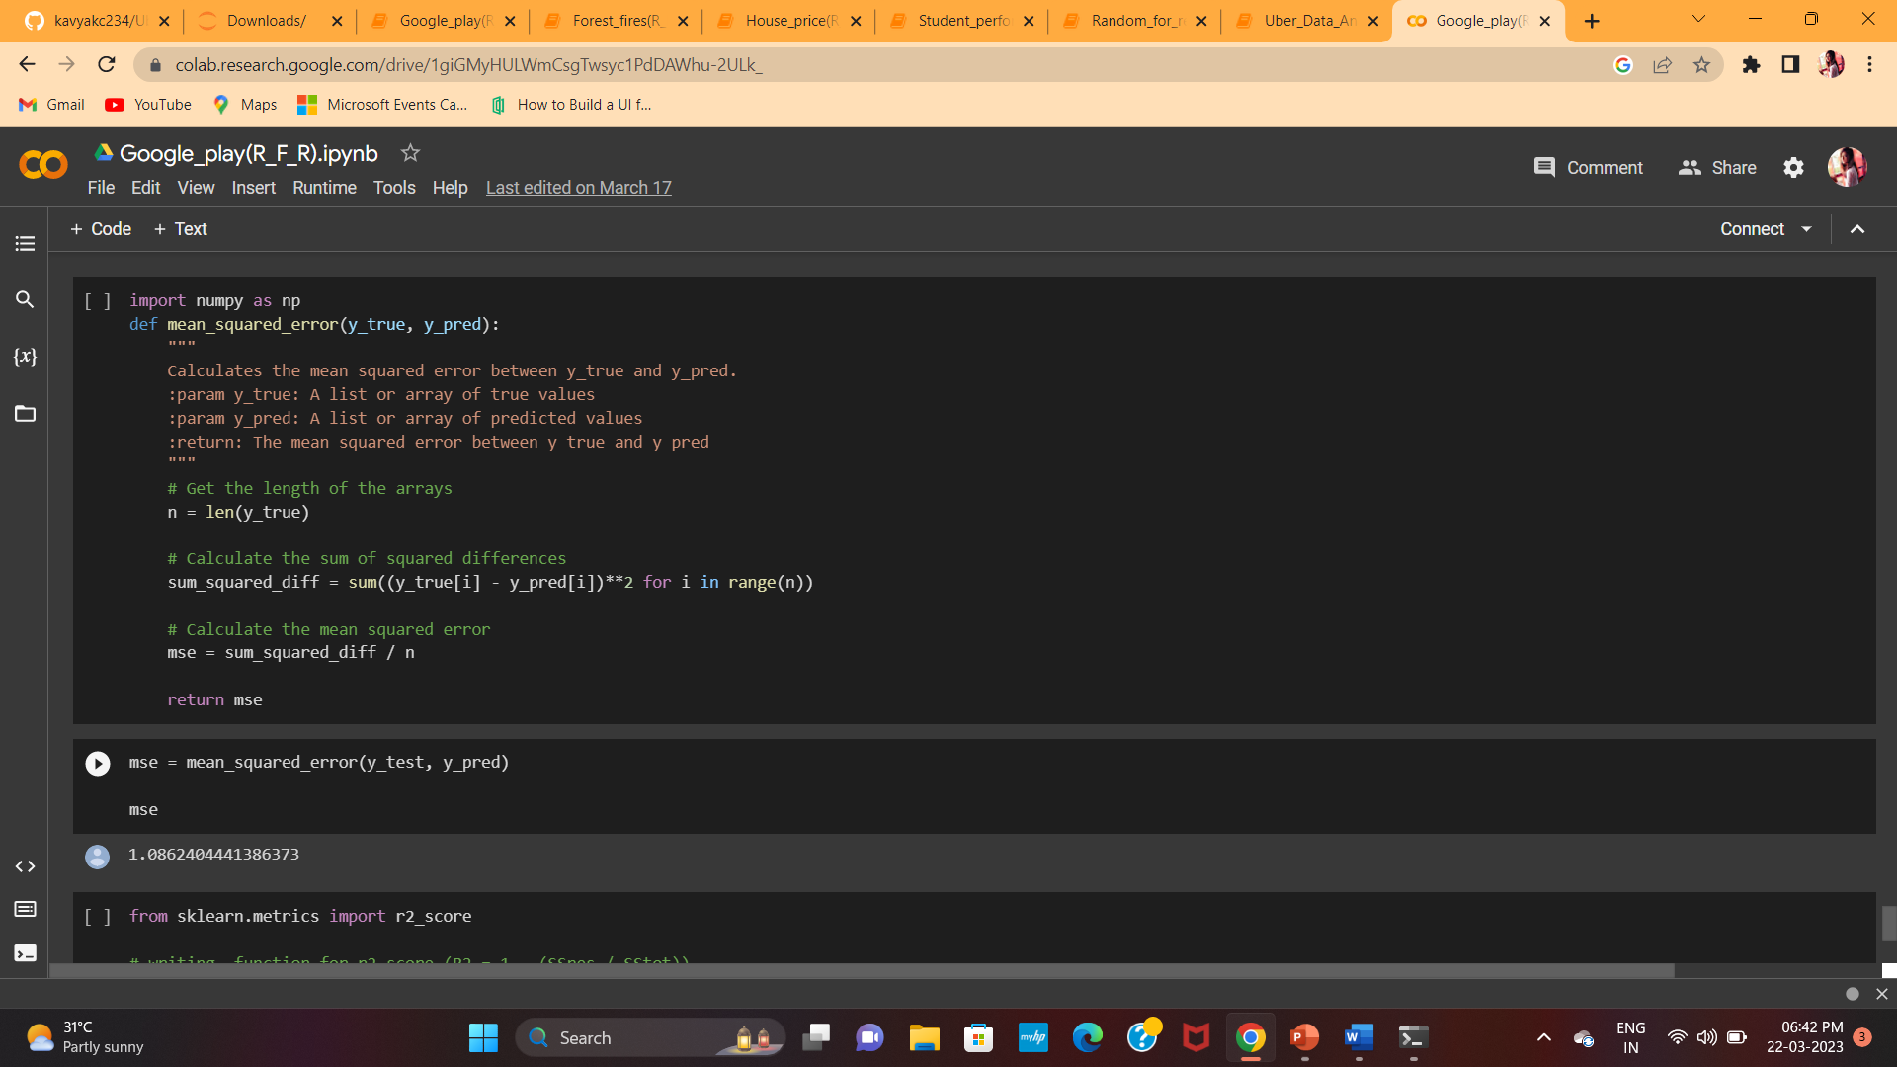
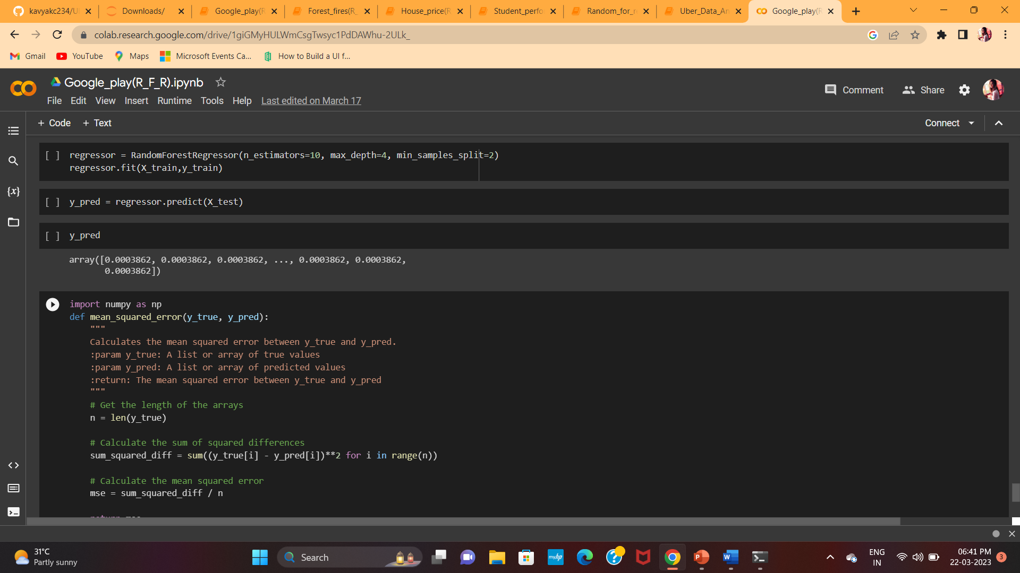
Google play store analysis
This dataset holds app data from 2010 until 2018. Each app (row) has values for catergory, rating, size, and more, this information is scraped from the Google Play Store. This app information would not be available without it.

Slide 29
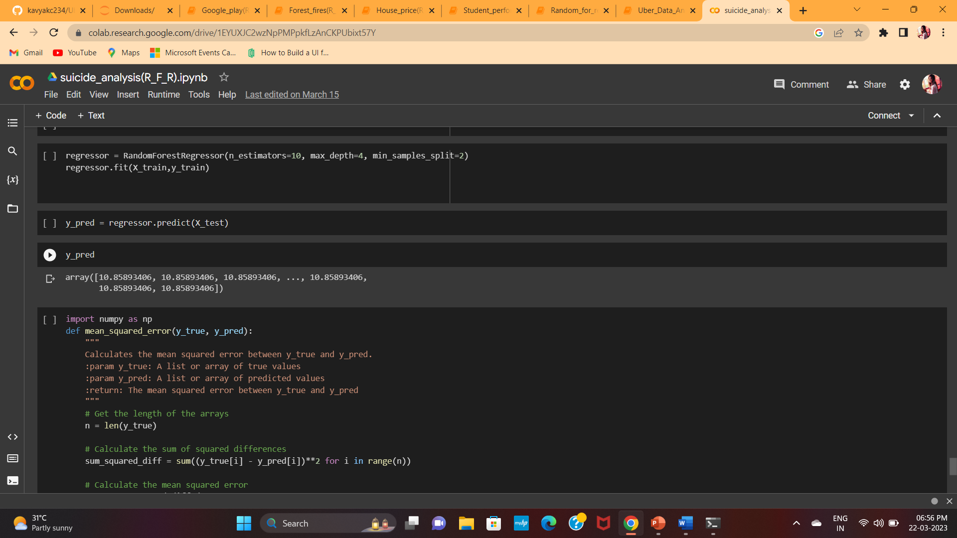
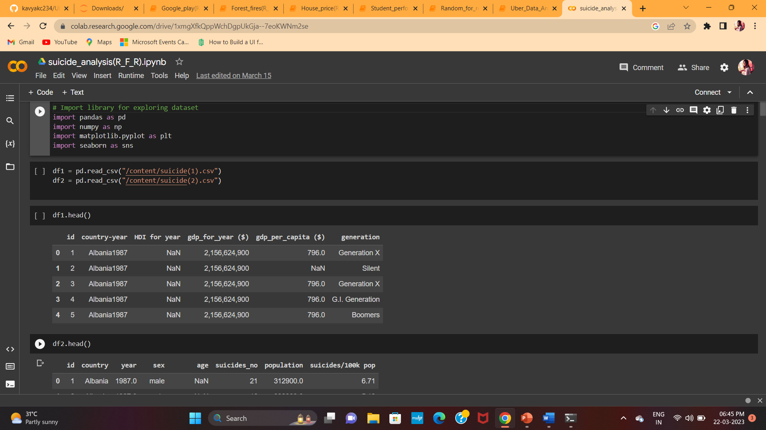
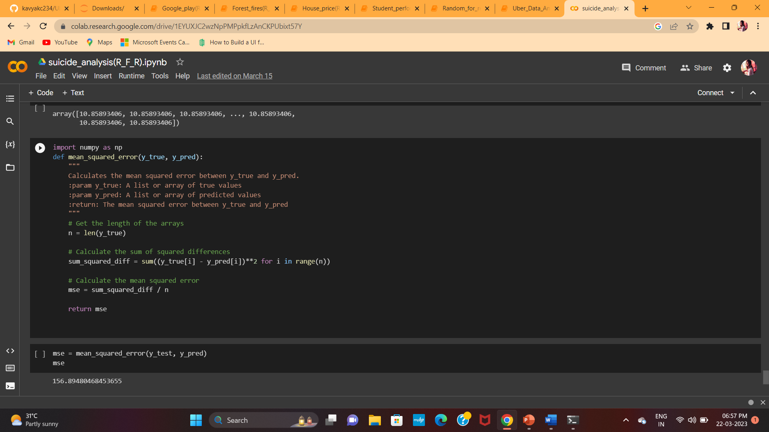
Suicide data analysis
This compiled dataset pulled from four other datasets linked by time and place, and was built to find signals correlated to increased suicide rates among different cohorts globally, across the socio-economic spectrum.

Slide 30
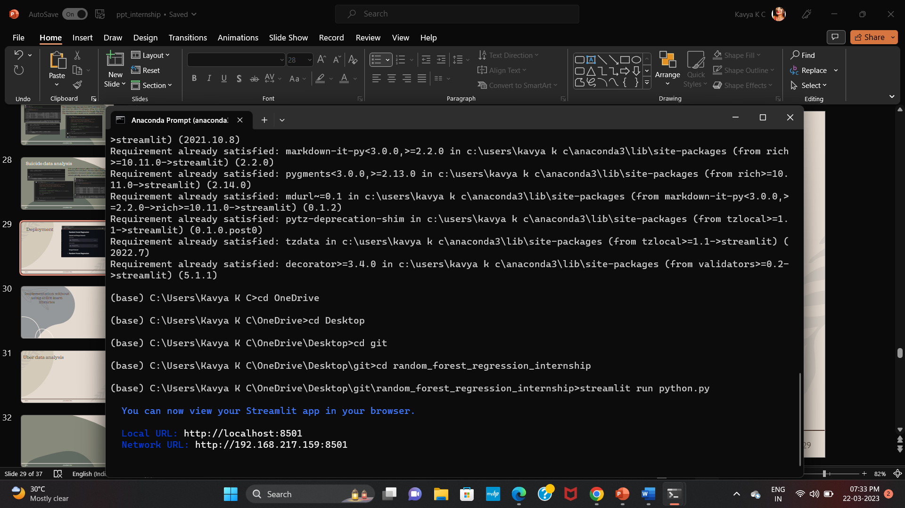


Deployment

Slide 31


Deployment

Slide 32



Deployment

Slide 33




Deployment

Slide 34




Deployment

Slide 35




Deployment

Slide 36
Advantages of Random forest regression
Advantages:
Random forest regression can handle high-dimensional datasets with a large number of features, without overfitting.
It is less sensitive to outliers and noise compared to other regression algorithms, as it takes the average of multiple decision trees.
Random forest regression is a highly accurate algorithm that can produce reliable predictions with a low error rate.
It can handle missing data and maintain accuracy in predictions, without requiring the removal of any data point

Slide 37
Disadvantages of random forest regression
Disadvantages:
Random forest regression is a black-box model, which means it is difficult to interpret and understand how it makes its predictions.
It can be computationally expensive, especially for large datasets with many features.
Random forest regression may not perform well on linear datasets or those that have a small number of features.
It may not be suitable for datasets with highly correlated features, as it can overemphasize the importance of these features.

Slide 38
Applications
Predictive modeling: Random forest regression is widely used in predictive modeling tasks such as predicting customer churn, stock prices, and housing prices.
Medical diagnosis: It can be used in medical diagnosis to predict the likelihood of certain diseases or conditions based on a patient's symptoms and medical history.
Environmental modeling: Random forest regression can be used in environmental modeling to predict weather patterns, air quality, and other environmental factors.
Marketing analytics: It can be used in marketing analytics to predict customer behavior and preferences, and to optimize marketing campaigns.
Image recognition: Random forest regression can be used in image recognition tasks to classify images based on their features and characteristics.
Natural language processing: It can be used in natural language processing to predict sentiment analysis, topic modeling, and other text-related tasks.
Financial forecasting: Random forest regression can be used in financial forecasting to predict stock prices, foreign exchange rates, and other financial metrics.

Slide 39

summary
Random forest regression is a powerful algorithm that can handle complex datasets and produce highly accurate predictions. However, it has some limitations that need to be considered before using it for a particular task.
Random forest regression can be applied to a wide range of industries and tasks that involve prediction or classification, making it a valuable tool for data scientists and machine learning engineers.

Slide 40
References
https://www.javatpoint.com/machine-learning-random-forest-algorithm
https://en.wikipedia.org/wiki/Ensemble_learning
https://towardsdatascience.com/random-forest-regression-5f605132d19d
https://www.analyticsvidhya.com/blog/2021/03/introduction-to-random-forest-and-its-hyper-parameters/

Slide 41
Thank you
Kavya K C
kavya1999kc@gmail.com
https://github.com/kavyakc234

